Slide 1
Domestic and Family Violence Services Regulatory Framework

Slide 2
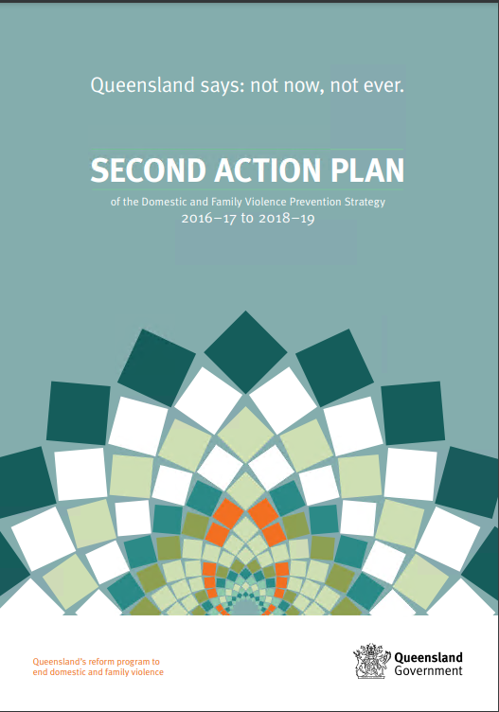
Why a regulatory framework?
Rec 82 of Not Now, Not Ever: Putting an end to domestic and family violence in Queensland:
c) [That the Queensland Government] establishes a clear and rigorous process for evaluating and approving initiatives and providing ongoing monitoring of compliance with the Practice Standards [for working with men who perpetrate domestic and family violence] to ensure that issues of non-compliance and service system development requirements are identified.
2nd Action Plan under the DFVP Strategy: Action to ‘develop a quality assurance framework and audit process to ensure ongoing compliance with the Professional Practice Standards for working with perpetrators of domestic and family violence.’

Slide 3
Practice Standards
Revised Practice Standards came into effect on 1 January 2021:
https://www.justice.qld.gov.au/about-us/services/women-violence-prevention/violence-prevention/service-providers/practice-principles-standards-guidance
Bring together all DFV service types under one consolidated set of standards (previously separate standards for women’s services and men’s services)
Updated to reflect:
improved practices and procedures that have been developed by specialist DFV services
contemporary theoretical frameworks
national and state policies and strategies
legislative amendments

Slide 4
What are practice standards?
Outline the everyday practice expectations of workers in the DFV system
Reflects the quality of services the community can expect from organisations that provide Queensland Government funded DFV services
Complement profession specific practice standards already in place for groups such as social workers, psychologists etc. (where applicable)

Slide 5
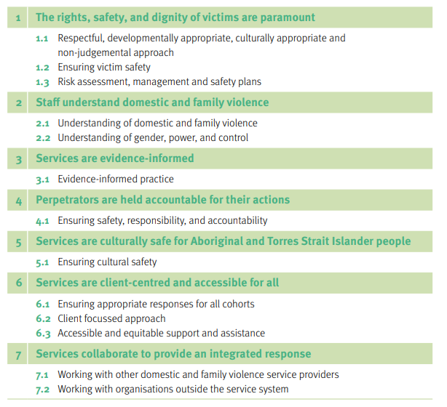
Structure of the Practice Standards
Principles
Outline what all clients – victims and perpetrators – should be able to expect from DFV services in Queensland
Standards
Outline a consistent approach to responding to DFV for all service sectors
Practice guidance
Translates the standards into practice
Elements that must be in place in order to give effect to the principles
Highlights activities and examples of practice that allow staff to meet each standard and bring the standards to life in their daily practice

Slide 6
Practice Standards Reflection
How would you rate your understanding and awareness of the practice standards?
How do the Practice Standards influence your practice, leadership and governance?
Is there anything that you have found helpful or beneficial in implementing the revised Practice Standards?

Slide 7
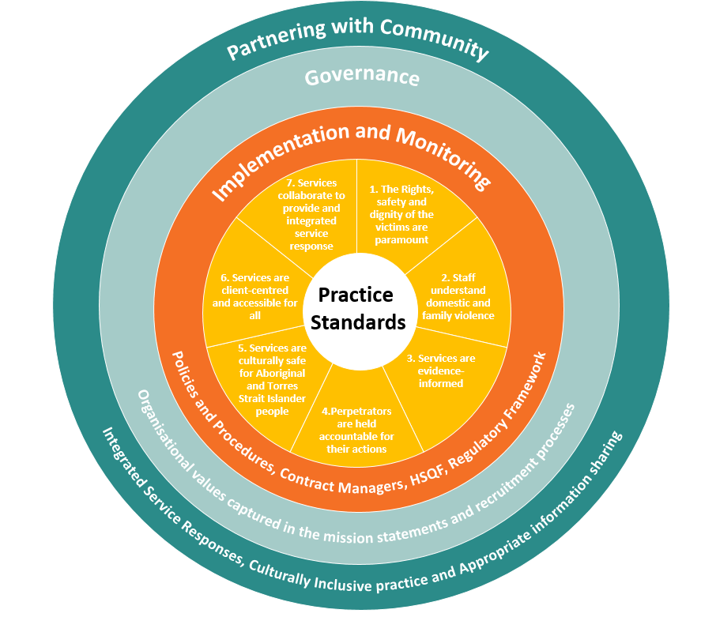
Framework Approach
Practice standards at the core (victim safety, perpetrator accountability and culturally safe and inclusive practice).
The implementation and monitoring of these standards are supported through current frameworks in place via funding agreements.
Embodied by services through their governance, core values and structure.
Key concepts are then incorporated and delivered through partnering with the community to deliver high quality services that are connected, safe and inclusive.

Slide 8
Service Delivery Context of the Regulatory Framework
Legal and contractual requirements
Monitoring and compliance
Community Services Act 2007
Human Services Quality Framework
Services must be certified as per the Human Services Quality Standards common requirements
DFV service providers
Investment Specifications
Set out requirements for service types and users
Domestic and family violence support services
Sexual violence services
Individual service agreements
Require services to be HSQF-compliant
Women’s health and wellbeing services
Other services
Domestic and Family Violence Regulatory Framework
Compliance with DFV Practice Standards
Domestic and Family Violence Protection Act 2012
WorkUP Queensland
Workforce capacity and capability building

Slide 9
Key Information
WHO
All department funded DFV services that includes: DFV support services, perpetrator intervention services, women’s shelters and integrated service responses funded through system support.
WHY
Promote greater consistency, transparency and integration of services around client needs reflects the quality of services the community
WHAT
The Regulatory Framework is a monitoring and compliance mechanism to ensure a high standard of service delivery across DFV services that demonstrates compliance with the Practice Standards.
WHEN
The Regulatory requires compliance from 1 January 2022
HOW
The Regulatory Framework is operationalised through the Human Services Quality Framework (HSQF), through DFV-specific criteria embedded into the HSQF user guide.

Slide 10
Development and Consultation
Guiding Principles of Development
As much as possible, to minimise the administrative burden and potential increase in costs to the DFV sector.
That the Regulatory Framework is designed and developed in response to sector feedback and expert advice.
That the Regulatory Framework is fit for purpose and appropriately operationalised to fit the sectors’ need.
Ensure that auditors have the specific skills and training to meaningfully and appropriately assess DFV practice.
Consultation Summary
There was a significant period of consultation from July 2020 to May 2021 to ensure that The Regulatory Framework is fit for purpose.
The development phase included extensive consultation with the wider DFV sector, targeted more at a management and organisational level.
Some key groups within consolation included:
Technical experts in auditing human services organisations;
Certification bodies;
DFV peak bodies;
Key stakeholders within the DFV sector;
Service representatives who formed working groups for the project

Slide 11
Who does the Regulatory Framework apply to?
WHO
WHY
WHAT
WHEN
HOW
All funded DFV services will be required to comply:
specialist DFV services including court support, women’s shelters and counselling (adult and children)
perpetrator intervention programs
integrated service responses funded by the Department
Research and events are not within scope of the Regulatory Framework
Non DFV specialist services may wish to voluntarily comply the Regulatory Framework with benefits including:
provide service that is inclusive and culturally appropriate,
better understand power, control and the gendered nature of violence,
be integrated and collaborative,
have the skills and capabilities to work effectively with a broad range of clients,
to promote greater consistency, transparency and integration of services around client needs.

Slide 12
The Purpose of the Regulatory Framework
WHO
WHY
WHAT
WHEN
HOW
Providing an effective system for monitoring compliance with the Practice Standards, while minimising administrative burden on the sector where possible.
Promoting practice consistency, and accountability, transparency and integration of services based on client needs.
Encouraging continuous improvement in service delivery, particularly regarding victim safety, perpetrator accountability and service integration across the sector.
Ensuring accessibility of DFV services for the full range of clients, in recognition of the diversity of the Queensland community.

Slide 13
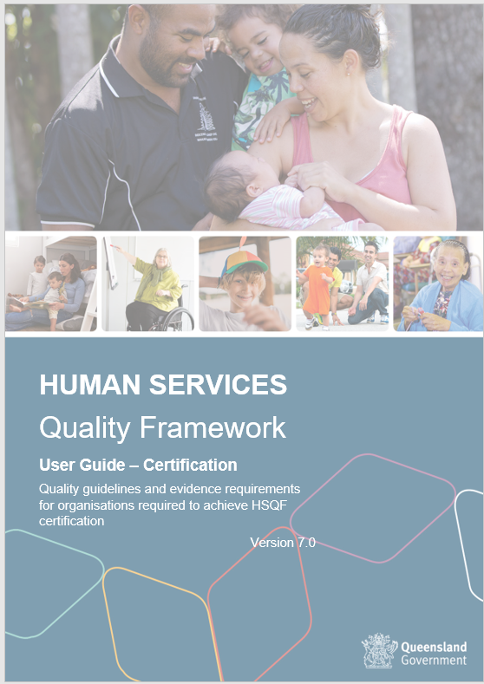
Human Services Quality Framework and Regulatory Framework
WHO
WHY
WHAT
WHEN
HOW
The Regulatory Framework is operationalised through the Human Services Quality Framework (HSQF), the Queensland Government’s existing monitoring and compliance framework in place for all funded human services organisations, including DFV specialist services
Specialist DFV criteria and suggested evidence has been developed and embedded into the HSQF user guide. The user guide sets out what services must demonstrate, and what evidence they could provide, to support an auditor to assess their DFV service delivery.
DFV services seeking certification or re-certification under the HSQF must demonstrate all common requirements for all indicators as outlined in the HSQF user guide, as well as the DFV specific requirements. In the HSQF user guide, these requirements are identifiable by the following icons:

Slide 14
Regulatory Framework Structure
WHO
WHY
WHAT
WHEN
HOW
Regulatory Framework document
HSQF Supplement and HSQF User Guide
Introduction and context
Compliance framework
Compliance requirements and guidance
Introduction and background
Why do we need a regulatory framework?
What has already been done?
What services are captured under the framework?
Assessment criteria Reflecting the new practice standards
What are the requirements services must comply with?
DFV Practice Standards
Background
Queensland’s reform agenda
Practice standards development
Evidence requirements Possible documentation, observation and interview evidence for each standard
How will compliance, non-compliance and complaints be assessed and measured?
Oversight
Alignment with HSQF
Audit processes
Quality assurance for auditors
Context / landscape
Queensland’s funded services
Legislation
Practice standards
Investment specifications
Service agreements

Slide 15
Overview of Regulatory Framework Criteria and Evidence
WHO
WHY
WHAT
WHEN
HOW
49 Practice Standards
29 HSQF Indicators
Regulatory Framework Criteria in 11 HSQF Indicators
Suggested evidence (no criteria) provided in 2 HSQF Indicators
Criteria
The criteria and suggested evidence are not intended to be restrictive or prescriptive, rather, they seek to identify the ‘what’ of good practice, rather than ‘how’ services should be delivered
The criteria identify the elements within the Practice Standards that are associated with best practice
Evidence
The suggested evidence within the Regulatory Framework has been developed to assist DFV practitioners, services and auditors to identify what best practice may look like in DFV service delivery
The evidence is not a ‘check list’ of what services should be delivering or have in place, but a series of examples of what may help demonstrate that services are meeting the criteria

Slide 16
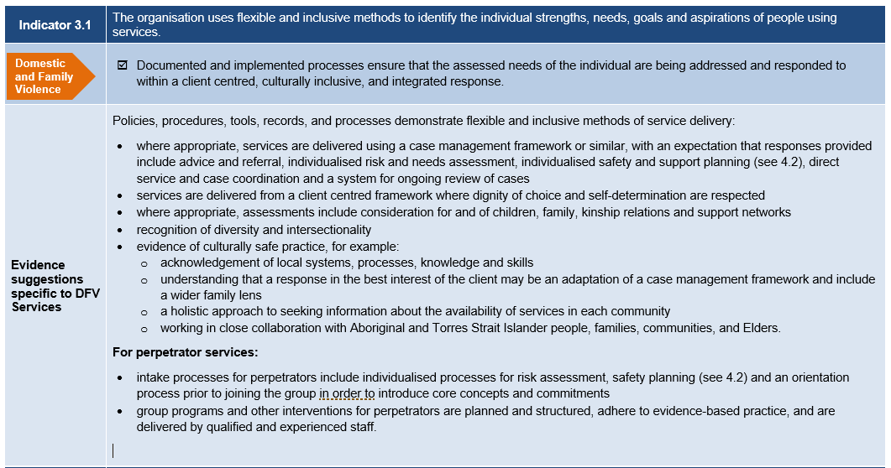
Criteria and suggested evidence
WHO
WHY
WHAT
WHEN
HOW
XXX

Slide 17
Timeline and Important Dates
WHO
WHY
WHAT
WHEN
HOW
July 2020
Practice Standards released
1 Jan 2021
Practice Standards came into effect
1 July 2021
Regulatory Framework published
1 Jan 2022
Regulatory Framework comes into effect
CONSULTATION & DEVELOPMENT
ON-BOARDING
COMPLIANCE
The Regulatory Framework criteria and suggested evidence will be published in the HSQF user guide on 1 October 2021
Services will be required to comply by 1 January 2022 through the HSQF audit process.
Delayed compliance for Aboriginal and Torres Strait Islander Services by 12 months and a grace period for shelters has also been endorsed.

Slide 18
Compliance Exemptions
Delayed compliance – Aboriginal and Torres Strait Islander Services (T310 funding stream)
There is an optional delayed compliance period of 12 months Aboriginal and Torres Strait Islander services to demonstrate their compliance under the Regulatory Framework (through their HSQF audits)
This is in recognition that Aboriginal and Torres Strait Islander services:
were not previously required to comply with the Practice Standards
may have different models of service provision, and
to support these services to maintain their culturally specific work
Services would not be required to be audited against the new DFV specific requirements as part of their HSQF certification process until their first scheduled audit after 1 January 2023, although they may still elect to as a preparatory exercise.
Major non-conformity exemption – Women’s Shelters
Shelters have been brought into the HSQF more recently and may not have the same level of experience preparing for audit as other services
Shelters will be exempt from major non-conformances during their first audit, if it falls within six months after 1 January 2022 (recertification or maintenance audit).
Shelters will therefore have additional time to address any major issues identified through the audit, consistent with the process for addressing standard non-conformances.

Slide 19
Scheme Rule Changes
Auditor Training/DFV Technical Expert
Sampling of Service Outlets
Scheme Rule:
All audit team members must be able to demonstrate a minimum level of DFV competence by:
having completed DFV practice training developed for auditors as specified by the HSQF team or
engaging a DFV technical expert to support the audit team
Rationale / benefits:
Certification Bodies were very supportive of DFV training for auditors
Auditors will have the option of also engaging a technical expert,
Scheme Rule:
“For human service organisations that deliver domestic and family violence services across multiple sites and/or outlets (including perpetrator intervention services and women’s shelters), the certifying body shall ensure that 100% of sites/outlets are sampled at least once during the three-year certification cycle.”
Rationale / benefits:
No/low additional workload for auditors as overall number of outlets sampled at each audit won’t significantly change
Ensures every outlet is sampled once every three years. Auditors can’t sample the same outlets every time

Slide 20
Supporting the sector to implement the Regulatory Framework
Audit Support Funding
All services funded by the DJAG to provide DFV services will be provided with additional one-off discretionary funding to support compliance with the Practice Standards through the Regulatory Framework.
This funding is intended to be used to support compliance through either:
assisting with the audit costs associated with the services first audit under the Regulatory Framework, or
used to support services in becoming compliant (for example, amending policies, procedures and processes to ensure alignment with compliance requirements).
Auditor Training
Any auditor auditing a DFV service under the Regulatory Framework will be required to complete departmentally provided DFV training.
This training is to ensure auditors have the necessary knowledge, nuanced understanding, and skill to appropriately audit DFV practice using the Regulatory Framework criteria
The first training will be delivered in November 2021, with ongoing delivery on a needs basis.
Resources
Factsheet summarises the key information and operationalisation of the Regulatory Framework.
Services self-assessment document has been developed to support services in doing a self-assessment against the Regulatory Framework criteria and evidence, relevant practice standards across the HSQF indicators.
Online webinar will be uploaded to the webpage, following live state-wide delivery. The webinar is intended to outline the purpose, operationalisation and preparation required for services to be compliant with the Regulatory Framework by 1 January 2021.

Slide 21
WorkUp Queensland
Capability and capacity building body for the domestic and family violence, sexual violence and women's wellbeing services
Partnership between ANROWS and the Aboriginal and Torres Strait Islander Healing Foundation
WorkUp Queensland also offers:
practice studios,
knowledge circles,
professional development and
workforce planning for the DFV sector
can assist services in preparing for the implementation of the Regulatory Framework.

Slide 22
Next Steps for Services
Read and understand both the Framework document and HSQF supplement that includes the DFV criteria and suggested evidence
Review our resources on our dedicated service provider webpage
Communicate with staff regarding the implementation of the Regulatory Framework and any changes required to practice
Provide and encourage staff to undertake professional development if needed
Review organisational policies and procedures and update as needed
Implement continuous monitoring and improvement processes.

Slide 23
Practice Principles and the Regulatory Framework
The Practice Standards are informed by a range of theoretical frameworks that underpin good practice in responding to the needs of both victims and perpetrators of violence. These practice principles are embedded within the Regulatory Framework and are core elements of DFV practice.
Victim Safety
Perpetrator Accountability
Integration
Inclusion and Accessibility
Principle 1 – The rights, safety and dignity of victims are paramount
Principle 2 – Staff understand domestic and family violence
Principle 5 – Services are culturally safe for Aboriginal and Torres Strait Islander people
Principle 6 – Services are client-centred and accessible for all
Principle 3 – Services are evidence-informed
Principle 4 – Perpetrators are held accountable for their actions
Principle 7 – Services collaborate to provide an integrated response

Slide 24
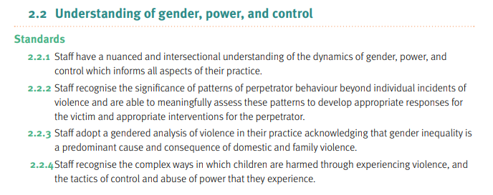
Principle 2 - Staff understand Domestic and Family Violence
Victim Safety
Victim Safety
Perpetrator Accountability
Integration
Inclusion and Accessibility
A gendered lens acknowledges the power imbalance that underpins domestic and family violence and how perpetrators exercise power and control over victims
Intersectionality is important and ensures that victims experience and understand violence in different ways based on intersecting experiences with other forms of disadvantage, for instance related to race, class, level of ability and sexuality.
Applying a ‘gender lens’ is vital for developing equitable policies, programs and services, and achieving gender equality.

Slide 25
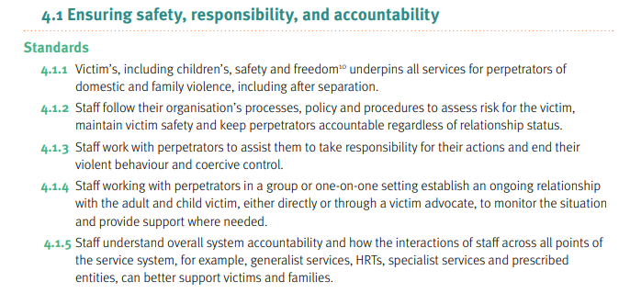
Principle 4 Ensuring safety, responsibility and accountability
Victim Safety
Perpetrator Accountability
Integration
Inclusion and Accessibility
Perpetrator Accountability
ensuring legal and police responses are adequate and include penalties for breach of orders
a focus on encouraging the perpetrator to understand and take responsibility for their actions
a focus on avoiding collusion with perpetrator or unintentionally reinforcing violence supportive attitudes and behaviours.
System Accountability
delivering high quality services through compliance processes,
providing responses that support perpetrator accountability and victim safety through integrated services responses and with a view to continuous improvement.

Slide 26
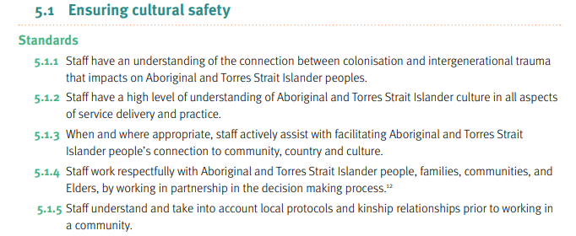
Principle 5 Ensuring Cultural Safety
Victim Safety
Perpetrator Accountability
Integration
Inclusion and Accessibility
Cultural Safety Definition
Is determined by Aboriginal and Torres Strait Islander Peoples.
Respect and recognition of cultural differences, by acknowledging that Aboriginal and Torres Strait Islander Peoples are the First Nations Peoples.
Creating environments where peoples feel safe and there’s no challenge to their identity and their needs can be met. This has ties to the physical environment, language, social structures, symbolic actions, sharing power, and developing knowledge, understanding and learning.
Is the responsibility of all individuals, services and organisations through an understanding and acknowledgement of past injustices and
Partnerships
Participation
Protection
Reform

Slide 27
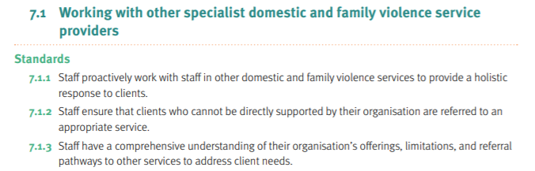
Principle 7 Services collaborate to provide an integrated response
Victim Safety
Perpetrator Accountability
Integration
Inclusion and Accessibility
Integrated Service Response:
Integration is widely regarded as “best practice” in service responses to domestic and family violence.
Integrated service responses are focused on the social and political structures that reinforce the safety of women and children and hold perpetrators to account for their behaviour.
Formal/funded: may include High Risk Teams (HRT), hubs or other funded and established integration responses as a component of coordinated the integrated responses from services.
Informal/unfunded: localised networks that relationships between agencies, organisations and communities that support integration and appropriate information sharing.

Slide 28
Integration in Practice
Processes for risk assessment and safety planning
Common Risk and Safety Framework
May vary dependant on the level of formal integration.
May include localised policies, state or national frameworks and legislation, High Risk Teams and integration Hubs that coordinate responses
Process & Practice
Authorising environment
Integration
Information Sharing
Formal and informal system accountability mechanisms
Established mechanisms that delineate referral processes and pathways, access to shared case-management etc
Information Sharing Guidelines (2016)
Services share information across all levels of practice from staff, managers and through the governance structure

Slide 29
Embedding Principles into Practice
Ensuring that culturally safe practice, beliefs and understanding is embedded in all levels of an organisation from governance through to policy and demonstrated in practice is crucial.
It is important that these core principles are measurable in some form, and that any measure should seek to also address governance, senior management and practitioner practice requirements
Governance
Workplaces
Individual practice
PRACTICE STANDARDS
LEVEL | EXAMPLE
Individual practice | Understanding and engaging in reflection Holding perpetrators to account in each contact Officer level integration
Workplaces | Reflective supervision Ensuring appropriate training and personal development Local and regional accountability (between services)
Governance | System level accountability (compliance, audits) Robust policies and procedures System level integration

Slide 30
Regulatory Framework Reflection
How do you perceive the Regulatory Framework will influence your practice, leadership and governance?
What is something you think you can implement to align practice with the Regulatory Framework?
What other information, resources and training do you feel would support improved understanding and compliance with the Regulatory Framework?

Slide 31
Visit our dedicated service provider webpage: https://www.justice.qld.gov.au/about-us/services/women-violence-prevention/violence-prevention Contact: your regional Contract Officers Email: The DFV Service System Reform Team at DFVServiceSystemReform@justice.qld.gov.au
For more information

