Slide 1
Gambling and domestic and family violence
Notes:
Version: September 2024.

Slide 2
Just to let you know…
Some of the content we are about to talk about in the next few slides might be difficult or confronting
If you think engaging in a conversation about domestic and family violence might be harmful or distressing for you right now, we understand
1800 RESPECT: 1800 737 732 | www.1800respect.org.au
DV Connect: 1800 811 811 | www.dvconnect.org
Notes:
Speaker’s notes:
Some of the content we are about to talk about in the next few slides might be difficult or confronting. If you think engaging in a conversation about domestic and family violence might be harmful or distressing for you right now, we understand. We encourage you to step outside for the next 15-20 minutes.
Please know help is available. You can find free and confidential support using the contact information displayed on screen.

Slide 3
Overview
What is domestic and family violence?
Types of DFV
Gambling and DFV
Financial abuse
Other considerations
Support services
Notes:
Speaker’s notes:
In this module, we’re going to talk about the link between gambling and domestic and family violence (DFV). We’ll start with a definition of DFV, explore the different types of DFV, its link to gambling, and talk about available support services.

Slide 4
What is domestic and family violence?
Refers to any violent, threatening or controlling behaviour that causes harm within intimate partner relationships, families and broader communities
Can happen to anyone, at any time, no matter their age, gender or sexual orientation
Can happen anywhere, including at home, school, work, or religious and community settings
Notes:
Speaker’s notes:
Domestic and family violence, or DFV, refers to any behaviour that causes physical, emotional, or psychological harm within intimate partner relationships, families and broader communities. It is any behaviour that is violent, threatening, controlling or intended to make someone feel scared or unsafe. It can happen to anyone, at any time, no matter their age, gender or sexual orientation. It can happen anywhere, including at home, school, work, or religious and community settings. DFV can continue even after someone has left a violent relationship. It is never a person’s fault if they experience DFV and coercive control. It is the responsibility of the person using controlling or abusive behaviours to stop hurting those they say they care about.
References:
Gambling Help Online. (2024). Gambling and family violence. https://www.gamblinghelponline.org.au/support-yourself-or-others/understanding-gambling/gambling-and-family-violence
Australian Government. (2024). What is family and domestic violence. https://www.servicesaustralia.gov.au/what-family-and-domestic-violence
Queensland Government. (2024) What is domestic and family violence? https://www.qld.gov.au/community/getting-support-health-social-issue/support-victims-abuse/need-to-know/domestic-and-family-violence/what-is-domestic-and-family-violence

Slide 5
Types of DFV
Physical
Verbal
Emotional
Psychological
Sexual
Social isolation
Spiritual
Cultural
Financial
Notes:
Speaker’s notes:
Violent or abusive behaviour can mean many different things, so it looks different in every setting. However, it’s important to know, DFV is much more than just physical. It includes:
Physical - Any actual or threatened attack on someone’s body or physical safety, like using intimidating body language, holding or restraining someone, and throwing things.
Verbal - Any behaviour involving the use of words, whether spoken or written (including online), to cause harm to a person – like yelling, putting down, name calling, and belittling behaviours.
Emotional - Any behaviour that undermines another person’s self-worth, confidence and independence. It can include name calling or insults, gaslighting, ridiculing or shaming, intentionally causing embarrassment or guilt, and threatening to harm oneself or other people.
Psychological - Any behaviour that threatens or causes fear in a person which is used in order to control them, like coercion, defamation, verbal insults or harassment.
Sexual - Any actual or threatened sexual contact without consent, like unwanted touching, exposing oneself, or having sex without consent.
Social isolation - Any behaviour that limits, controls or interferes with someone’s social activities or relationships with others, like excessive questioning, monitoring movements and social communications, and preventing someone from having contact with family or friends.
Spiritual - Any behaviour that uses a person’s spiritual or religious beliefs to manipulate, dominate, or control them, like preventing them from attending religious gatherings, preventing them from practicing their faith, or ridiculing their beliefs.
Cultural - Any behaviour that uses an aspect of a person’s culture, religion, or tradition to control them, like belittling a person’s cultural beliefs or practices, violating or preventing these practices, or denying access to their cultural community.
Financial - Any behaviour that controls a person’s financial resources without the person’s consent or misuses those resources, like stealing money or property, denying someone access to their own money, incurring debts in someone’s name, and making financial decisions without consultation.
References:
Gambling Help Online. (2024). Gambling and family violence. https://www.gamblinghelponline.org.au/support-yourself-or-others/understanding-gambling/gambling-and-family-violence

Slide 6
Gambling and DFV
Research tells us that people experiencing gambling harm are more likely to experience DFV and/or to act violently themselves
People who gamble can become violent towards their loved ones, or loved ones can also be violent towards the person who gambles
Some people use gambling as a coping mechanism to deal with the violence they are experiencing or inflicting
Notes:
Speaker’s notes:
Sometimes, gambling harm and DFV can happen together. Gambling can put immense pressure on families and relationships. It can increase stress, tension and conflict. Sometimes, that conflict can lead to violence. Research tells us that people experiencing gambling harm are more likely than others to experience DFV and/or to act violently themselves. We know that people who gamble can be become violent towards their loved ones as their gambling losses or gambling-related stresses increase. However, loved ones can also be violent towards the person who gambles, as their gambling-related losses and stresses increase. Likewise, many people use gambling as a coping mechanism. Some people gamble to physically or emotionally escape from violence they’re experiencing at home; while other people can gamble to try to deny or forget about their own violent behaviour. Regardless of how they are connected, there can be a complex and difficult link between gambling and DFV.
References:
Gambling Help Online. (2024). Gambling and family violence. https://www.gamblinghelponline.org.au/support-yourself-or-others/understanding-gambling/gambling-and-family-violence

Slide 7
Financial abuse
Refers to when someone controls or manipulates another person’s finances
Common amongst relationships where gambling is present
Sometimes used to gain control over the family’s finances to gamble or pay off debts, or to limit another family member’s gambling
Notes:
Speaker’s notes:
Financial abuse is when someone controls or manipulates another person’s so that they have power over them. This type of abuse is common in relationships or families where someone is experiencing gambling harm. Some people who gamble may attempt to gain control of the family’s finances to get more money to gamble or pay off debts. Likewise, family members may also restrict financial access to the person who gambles in an attempt to get some control over the family finances.
References:
Gambling Help Online. (2024). Gambling and family violence. https://www.gamblinghelponline.org.au/support-yourself-or-others/understanding-gambling/gambling-and-family-violence

Slide 8
Other considerations
The connection between gambling and DFV is complex
It can involve many other factors, including…
Family crisis and relationship breakdown
Financial stress
Mental ill-health
Substance misuse
Homelessness
Other life stresses
Notes:
Speaker’s notes:
It’s important to understand that the connection between gambling and DFV is complex. It can involve many other factors, including financial stress, mental ill-health, substance misuse, homelessness, and other life stresses like work or study stress. Sometimes people feel unsure about asking for help or don’t feel they can, but it’s important to protect yourself and your family and to learn how to deal with what is going on in your life.
References:
Gambling Help Online. (2024). Gambling and family violence. https://www.gamblinghelponline.org.au/support-yourself-or-others/understanding-gambling/gambling-and-family-violence

Slide 9
Support services
Free and confidential counselling
Support is available either face-to-face, over the phone or online
Phone us:
Visit our website:
Notes:
Note for presenter:
Please include the relevant GHS phone number and hours.
Speaker’s notes:
If you or someone you know is experiencing gambling harm, you can seek help from our support services. We offer free and confidential counselling services to both the person experiencing gambling harm and the people close to them. You can seek this support either face-to-face, over the phone or online. Our counsellors will always provide non-judgmental support. We’ll talk about the reasons you’ve decided to seek help and make plans together for the changes we can make to your gambling, your relationships and your life. You can find our phone number and website on the screen.

Slide 10
Other local support services
Support service | Contact information
Mental health support
Domestic and family violence
Alcohol and other drug use
Financial counselling
Notes:
Note for presenter:
Please include a list of some other local support services.
Speaker’s notes:
Sometimes, people gamble because there are other factors in their life that are causing them stress or difficulty. We’ve compiled a list of some of the other support services in our area, including services to help people experiencing mental health concerns, domestic and family violence, alcohol and other drug use, or financial difficulty. You can use these services to get the other support you might need.

Slide 11
Support services
1800 RESPECT
1800 737 732
www.1800respect.org.au
DV Connect
1800 811 811
www.dvconnect.org
Notes:
Speaker’s notes:
If you or someone you know is experiencing domestic and family violence, you can also seek help from other support services. 1800 RESPECT and DV Connect are free, confidential services that provide 24/7 support to people experiencing DFV across Australia. Their counsellors are professionally qualified and experienced in DFV support and guidance. You can contact them using the information displayed on screen.
References:
1800 RESPECT. (2024). National Domestic Family and Sexual Violence Counselling Service. https://www.1800respect.org.au
DV Connect. (2024). About us. https://www.dvconnect.org/about-us/

Slide 12
Gambling Help support services
Gambling Help Queensland
1800 858 858
www.gamblinghelpqld.org.au
Gambling Help Online
1800 858 858
www.gamblinghelponline.org.au
Notes:
Speaker’s notes:
There are also other services available, outside of our local area. Gambling Help Queensland provide 24/7 support for anyone affected by gambling across Queensland, through their free hotline displayed on screen. Find more information at the Gambling Help Queensland website.
Gambling Help Online provide 24/7 free online support across Australia. You can speak to a counsellor either on an online chat, email or over the phone at any time of the day. You can find more information at the Gambling Help Online website.
References:
Gambling Help Queensland. (2024). Home. www.gamblinghelpqld.org.au
Gambling Help Online. (2024). Home. www.gamblinghelponline.org.au

Slide 13
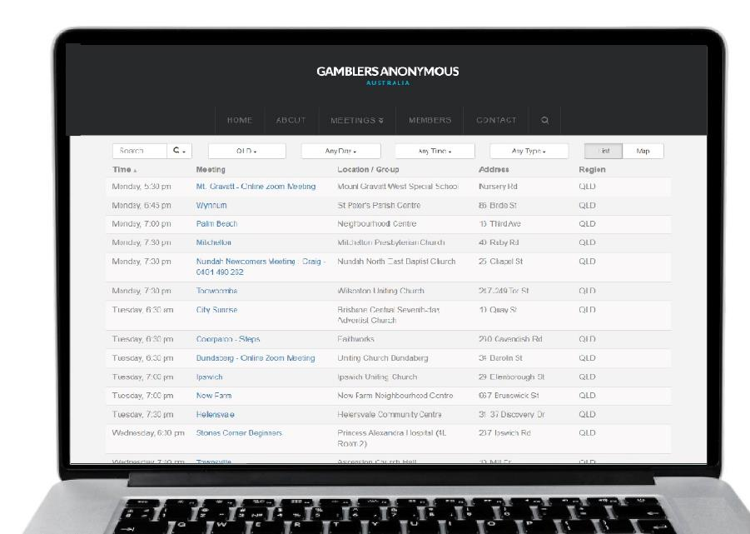
Group therapy support services
Gamblers Anonymous Queensland
0467 655 799
www.gaaustralia.org.au
Gam-Anon Queensland
0467 655 799
www.gaaustralia.org.au/gam-anon/
Notes:
Speaker’s notes:
There are also various support groups available. Gamblers Anonymous Queensland provides group therapy and support across Queensland. Members can meet either face-to-face or online, either weekly or whenever suits them, to listen and speak with other people who are experiencing similar gambling-related challenges. You can find more information about session times and locations at the Gamblers Anonymous Australia website, by clicking the ‘Queensland meetings’ tab.
Similarly, Gam-Anon Queensland provides group therapy for people impacted by someone else’s gambling, including partners, family, friends and colleagues. Members can also meet either face-to-face or online. You can find more information at the website on screen.
References:
Gamblers Anonymous. (2024). Home. www.gaaustralia.org.au

Slide 14
Crisis support
Notes:
Speaker’s notes:
If anything we have talked about today raises immediate concern for you, please know you are not alone. Help is always available. You can call the number on the screen or visit the Lifeline website.
References:
Lifeline. (2024). Home. www.lifelineqld.org.au

Slide 15
Questions?

