Slide 1
Gambling and substance use
Notes:
Version: September 2024.

Slide 2
Just to let you know…
Some of the content we are about to talk about in the next few slides might be difficult or confronting
If you think engaging in a conversation about substance misuse might be harmful or distressing for you right now, we understand
Counselling Online: www.counsellingonline.org.au
National Alcohol & Other Drug Hotline: 1800 250 015
Notes:
Speaker’s notes:
Some of the content we are about to talk about in the next few slides might be difficult or confronting. If you think engaging in a conversation about substance misuse might be harmful or distressing for you right now, we understand. We encourage you to step outside for the next 15-20 minutes.
Please know help is available. You can find free and confidential support using the contact information displayed on screen.

Slide 3
Overview
What is substance use?
Signs of substance misuse
Gambling and substance use
Strategies to support yourself
Strategies for safer gambling
Support services
Notes:
Speaker’s notes:
In this module, we’re going to talk about the link between gambling and substance use. We’ll start with a definition of substance use, explore the signs of substance misuse, its link to gambling, and talk about strategies to look after yourself and available support services.

Slide 4
What is substance use?
Refers to the use of alcohol, tobacco and other drugs
Includes legal drugs, illegal drugs and prescribed medications
Substance misuse refers to when a person uses these substances too much, causing harm to themselves or others
Notes:
Speaker’s notes:
Substance use refers to the use of alcohol, tobacco and other drugs. This can include the use of legal drugs - like alcohol and tobacco, illegal drugs – like marijuana, cocaine and hallucinogens, or controlled use like prescribed medications, including opioids.
Sometimes, a person might use these substances too much, struggle to control the frequency and the amount used, or continue to use these substances even when it causes harm. This harm can be caused to both themselves or other people around them and can include impacts to a person’s physical and mental health, personal relationships, and work, study, social or cultural responsibilities. When someone uses alcohol or other drugs to the point that it becomes harmful, it is called ‘substance misuse’.
References:
McLellan A. T. (2017). Substance Misuse and Substance use Disorders: Why do they Matter in Healthcare?. Transactions of the American Clinical and Climatological Association, 128, 112–130.
Alhammad, M., Aljedani, R., et al. (2022). Family, Individual, and Other Risk Factors Contributing to Risk of Substance Abuse in Young Adults: A Narrative Review. Cureus, 14(12), e32316. https://doi.org/10.7759/cureus.32316
Gambling Help Online. (2024). Gambling and substance use. https://www.gamblinghelponline.org.au/support-yourself-or-others/understanding-gambling/gambling-and-alcohol

Slide 5
Substance misuse risk factors
Major life changes
Increased stress
Mental health concerns
Experiences of domestic and family violence
Previous exposure to substance misuse
Notes:
Speaker’s notes:
Substance misuse is often connected to or caused by many different factors. This can include recent major changes in life, increased stress, struggles with mental health, experiences of domestic and family violence, and previous exposure to substance misuse, such as having a close family member or friend who has experienced alcohol or other drug concerns.
References:
McLellan A. T. (2017). Substance Misuse and Substance use Disorders: Why do they Matter in Healthcare?. Transactions of the American Clinical and Climatological Association, 128, 112–130.
Alhammad, M., Aljedani, R., et al. (2022). Family, Individual, and Other Risk Factors Contributing to Risk of Substance Abuse in Young Adults: A Narrative Review. Cureus, 14(12), e32316. https://doi.org/10.7759/cureus.32316

Slide 6
Signs of substance misuse
Using substances in larger amounts or more often than intended
Struggling to reduce or stop using substances
Feeling strong cravings
Struggling to partake in other parts of life
Continuing to use substances even after it causes harm
Notes:
Speaker’s notes:
Substance misuse can look different and mean different things for everybody. However, there are several common signs you can look out for. These can include: drinking or taking drugs in larger amounts or more often than intended, struggling to reduce or stop using substances, spending a lot of time getting, using or recovering from drinking or taking drugs, feeling strong cravings to use substances, struggling to partake in work, study, personal, cultural or social responsibilities and activities due to alcohol or drugs, and continuing to drink or take drugs even after you think it is causing harm.
References:
Gambling Help Online. (2024). Gambling and substance use. https://www.gamblinghelponline.org.au/support-yourself-or-others/understanding-gambling/gambling-and-alcohol

Slide 7
Gambling and substance use
People who experience gambling harm are more likely to struggle with alcohol and other drugs
Often use substances as a coping mechanism for losing money
of people who experience gambling harm also struggle with substance misuse
60%
Notes:
Speaker’s notes:
Now, let’s talk about the link between gambling and substance use. Research tells us that people who experience gambling harm are more likely to struggle with alcohol and other drugs. About 60% of people who experience gambling harm also experience substance misuse.
Generally, people who are experiencing both gambling harm and substance misuse usually use alcohol and other drugs first, which makes them more likely to gamble. However, it can also work the other way too – where people who are experiencing gambling harm struggle with substance misuse because of the consequences of gambling, like using alcohol and other drugs as a coping mechanism for losing money. This can be particularly difficult because many gambling venues serve alcohol, so it’s common for people to drink and gamble at the same time. It’s also easy for people to drink too much or take drugs when they’re gambling online at home. For these reasons gambling and substance use often become linked.
References:
Gambling Help Online. (2024). Gambling and substance use. https://www.gamblinghelponline.org.au/support-yourself-or-others/understanding-gambling/gambling-and-alcohol

Slide 8
Other considerations
The connection between gambling and substance misuse is complex
It can involve many other factors, including…
Family crisis or relationship breakdown
Financial stress
Mental ill-health
Domestic and family violence
Homelessness
Other life stresses
Notes:
Speaker’s notes:
It’s important to understand that the connection between gambling and substance misuse is complex. It can involve many other factors, including family crisis or relationship breakdown, financial stress, mental ill-health, domestic and family violence, homelessness, and other life stresses like work or study stress. It is important to be mindful of how the different parts of somebody’s life can affect a person and the choices they make.
References:
Gambling Help Online. (2024). Gambling and family violence. https://www.gamblinghelponline.org.au/support-yourself-or-others/understanding-gambling/gambling-and-family-violence

Slide 9
Strategies to support yourself
Monitor your gambling and substance use
Set limits on your gambling and substance use
Pay attention to the people around you
Notes:
Note for presenter:
More information/resources about self-exclusion and limit setting are available in the Self-exclusion and Limit setting module, including how to put exclusions, bank blocks and limits in place.
Speaker’s notes:
There are some strategies that you can adopt if you think your alcohol or drug use might be leading to gambling harm. You might like to try putting some of these in place next time you plan to use substances or to gamble. This includes:
Monitor your substance use and gambling - Keep track of when, how much and how often you drink or take drugs, and when, how much, and how often you gamble. It’s a good idea to write it down, so you can look back on it later. A useful way to do this is by keeping a log in the ‘Notes’ app on your mobile. Look to see how often you do both on the same day and in which order you do them. Keeping a record like this can give you a sense of how these behaviours might be connected.
Set limits – Think about the ways in which you can set limits on the time and money you spend gambling. You can do this by opting to exclude yourself from a gaming venue or product, setting limits through banking blocks, or limiting your gambling on pokies through pre-commitment programs. You can also limit the amount that you drink or use drugs. It’s a good idea to stick to the guidelines recommended by the Australian government – a maximum of 10 standard drinks per week, and no more than four standard drinks per day. It’s also best to only take legal drugs.
Pay attention to the people around you – Are there any people in your life who encourage you to keep drinking, taking drugs or gambling after you say you’ve had enough? Find ways to limit this risk, by talking to them about your concerns or choosing to spend time with those people at times or in places they’re not likely to gamble or use substances.
References:
Gambling Help Online. (2024). Gambling and substance use. https://www.gamblinghelponline.org.au/support-yourself-or-others/understanding-gambling/gambling-and-alcohol

Slide 10
Strategies for safer gambling
Understand the risk
Set limits with your money
Set limits with your time
Gamble with a clear mind
Maintain balance in life
Notes:
Speaker’s notes:
These strategies can help you avoid gambling harm and practice safer gambling.
Tip 1: Understand the risk.
When we’re honest with ourselves about the risks of gambling, it’s easier to understand that the likelihood of winning isn’t very high. Remember gambling is a business designed to make gambling providers money. There is a high chance you will lose, and the odds will always be in the house’s favour.
Tip 2: Set limits with your money.
Decide in advance the amount of money you will spend on gambling per week or month. Keep an eye on your current and past spending. Try look for patterns or trends.
Tip 3: Set limits with your time.
It can be easy to lose track of time. Set start times and finish times for when you will gamble. Choose an ideal duration for play. Set a timer to remind you to stop or take a break in play.
Tip 4: Only gamble with a clear mind.
Sometimes when we’re having fun, we can be tempted to gamble while drinking or using drugs. But this can be dangerous as it changes the way we make decisions. Likewise, try not to gamble when you’re feeling down, stressed or bored as this can also lead us to make different choices.
Tip 5: Maintain balance in your life.
Remember that gambling shouldn’t take up all of your time. It is important to balance your time with other important things in your life, like spending time with friends and family, playing a sport or starting a creative project. If you find that your gambling is taking up too much of your time or you’re spending less time partaking in other important parts of your life, it might be time to seek help.
References:
Gambling Help Queensland. (2024). Tips for Safer Gambling. https://www.gamblinghelpqld.org.au/tips-to-avoid-risky-gambling
Multnomah County. (2024). 10 Tips for Safer Gambling. https://www.multco.us/behavioral-health/10-tips-safer-gambling
Responsible Gambling Council. (2024). Take a Safer Approach to Gambling: How to take precautions from the risks of gambling (especially online). https://www.responsiblegambling.org/for-the-public/safer-play/safer-gambling-tips/

Slide 11
Support services
Free and confidential counselling
Support is available either face-to-face, over the phone or online
Phone us:
Visit our website:
Notes:
Note for presenter:
Please include the relevant GHS phone number and hours.
Speaker’s notes:
If you or someone you know is experiencing gambling harm, you can seek help from our support services. We offer free and confidential counselling services to both the person experiencing gambling harm and the people close to them. You can seek this support either face-to-face, over the phone or online. Our counsellors will always provide non-judgmental support. We’ll talk about the reasons you’ve decided to seek help and make plans together for the changes we can make to your gambling, your relationships and your life. You can find our phone number and website on the screen.

Slide 12
Other local support services
Support service | Contact information
Mental health support
Domestic and family violence
Alcohol and other drug use
Financial counselling
Notes:
Note for presenter:
Please include a list of some other local support services.
Speaker’s notes:
Sometimes, people gamble because there are other factors in their life that are causing them stress or difficulty. We’ve compiled a list of some of the other support services in our area, including services to help people experiencing mental health concerns, domestic and family violence, alcohol and other drug use, or financial difficulty. You can also speak to one of our counsellors and they can get you in touch with the other support you need.

Slide 13
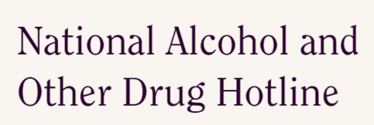
Support services
Counselling Online
www.counsellingonline.org.au/
National Alcohol & Other Drug Hotline
1800 250 015
Notes:
Speaker’s notes:
If you or someone you know is experiencing harm from their substance use, you can also seek help from other support services. Counselling Online and the National Alcohol and Other Drug Hotline are free, confidential services that provide 24/7 support to people affected by alcohol or other drug use across Australia. Their counsellors are professionally qualified and experienced in alcohol and drug counselling and treatment. They can help any time you need it, whether you need a quick chat to get you through a tricky moment, or a longer conversation to work through something harder. These services are also available for affected others, such as family and friends impacted by a loved one’s substance use. You can contact them using the information displayed on screen.
References:
Counselling Online. (2024). About us. https://www.counsellingonline.org.au/about-us
Australian Government. (2024). National Alcohol and Other Drugs Hotline. https://toolkit.lifeline.org.au/articles/support/national-alcohol-other-drug-hotline

Slide 14
Gambling Help support services
Gambling Help Queensland
1800 858 858
www.gamblinghelpqld.org.au
Gambling Help Online
1800 858 858
www.gamblinghelponline.org.au
Notes:
Speaker’s notes:
There are also other services available, outside of our local area. Gambling Help Queensland provide 24/7 support for anyone affected by gambling across Queensland, through their free hotline displayed on screen. Find more information at the Gambling Help Queensland website.
Gambling Help Online provide 24/7 free online support across Australia. You can speak to a counsellor either on an online chat, email or over the phone at any time of the day. You can find more information at the Gambling Help Online website.
References:
Gambling Help Queensland. (2024). Home. www.gamblinghelpqld.org.au
Gambling Help Online. (2024). Home. www.gamblinghelponline.org.au

Slide 15
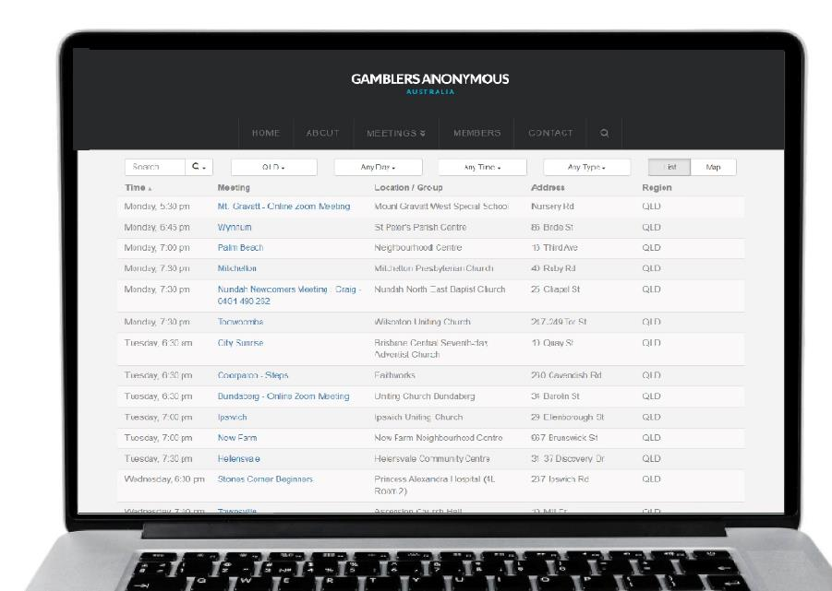
Group therapy support services
Gamblers Anonymous Queensland
0467 655 799
www.gaaustralia.org.au
Gam-Anon Queensland
0467 655 799
www.gaaustralia.org.au/gam-anon/
Notes:
Speaker’s notes:
There are also various support groups available. Gamblers Anonymous Queensland provides group therapy and support across Queensland. Members can meet either face-to-face or online, either weekly or whenever suits them, to listen and speak with other people who are experiencing similar gambling-related challenges. You can find more information about session times and locations at the Gamblers Anonymous Australia website, by clicking the ‘Queensland meetings’ tab.
Similarly, Gam-Anon Queensland provides group therapy for people impacted by someone else’s gambling, including partners, family, friends and colleagues. Members can also meet either face-to-face or online. You can find more information at the website on screen.
References:
Gamblers Anonymous. (2024). Home. www.gaaustralia.org.au

Slide 16
Crisis support
Notes:
Speaker’s notes:
If anything we have talked about today raises immediate concern for you, please know you are not alone. Help is always available. You can call the number on the screen or visit the Lifeline website.
References:
Lifeline. (2024). Home. www.lifelineqld.org.au

Slide 17
Questions?

