Slide 1
Gambling and the brain
Notes:
Version: September 2024.

Slide 2
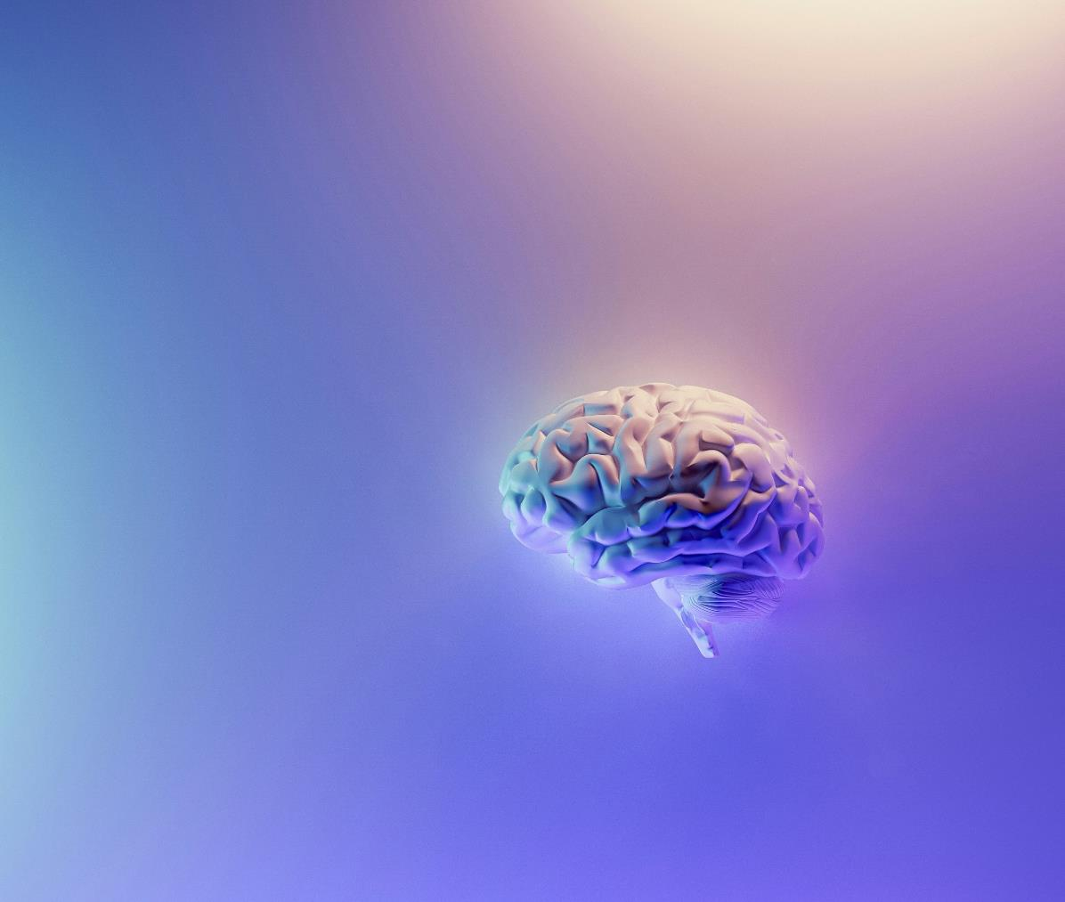
Overview
An introduction to dopamine
How gambling can change the brain
‘Near misses’
The impact on the brain
Useful tips for safer gambling
Notes:
Speaker’s notes:
The following slides will detail the impact of gambling on the brain. We’ll give an introduction to dopamine, explain how gambling can change the brain, the concept of ‘near misses’ and its impact, and provide some tips for safer gambling.

Slide 3
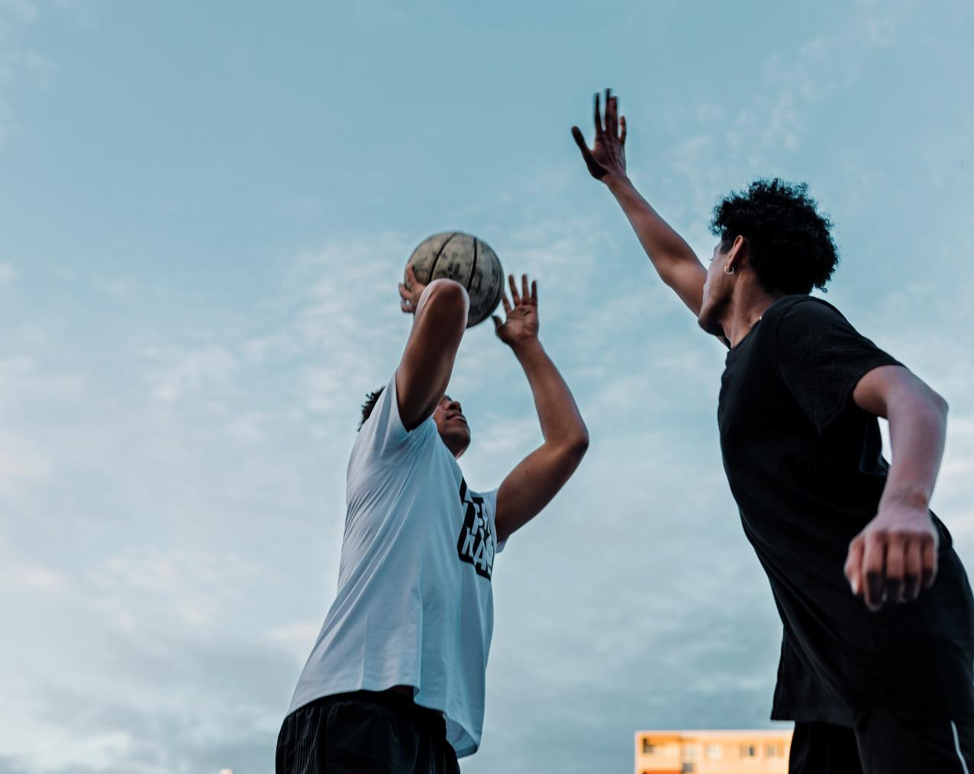
What is dopamine?
A chemical that makes people feel good
Plays a role in many body functions
Released during activities that are fun and enjoyable
Notes:
Speaker’s notes:
Dopamine is a chemical produced in the brain that makes us feel good. It plays a big role in our memory, mood, sleep, learning, concentration, movement and many other body functions.
Dopamine is released in our brains when we do something that gives us satisfaction or pleasure, like eating good food, playing sport, and spending time with family and friends. It is also released when we drink alcohol or use drugs.
References:
Anselme, P., & Robinson, M. J. (2013). What motivates gambling behavior? Insight into dopamine's role. Frontiers in behavioral neuroscience, 7, 182. https://doi.org/10.3389/fnbeh.2013.00182

Slide 4
Gambling can change the brain
Gambling often can make it harder to get that good feeling
Can lead someone to gamble more frequently
Can result in cravings
Notes:
Speaker’s notes:
Dopamine is released in the brain when someone gambles. It helps us feel good and makes us want to keep gambling, so we can continue to feel good. But when someone gambles often, the brain can get used to the dopamine, which can make it harder to keep getting that good feeling. This might lead someone to gamble more and more to feel the same level of pleasure. It can also lead someone to crave gambling, like experiencing a rush or a high.
References:
Anselme, P., & Robinson, M. J. (2013). What motivates gambling behavior? Insight into dopamine's role. Frontiers in behavioral neuroscience, 7, 182. https://doi.org/10.3389/fnbeh.2013.00182
Gambler’s Help. (2024). Gambling and how it affects the brain. https://gamblershelp.com.au/learn-about-gambling/gambling-and-how-it-affects-the-brain/

Slide 5
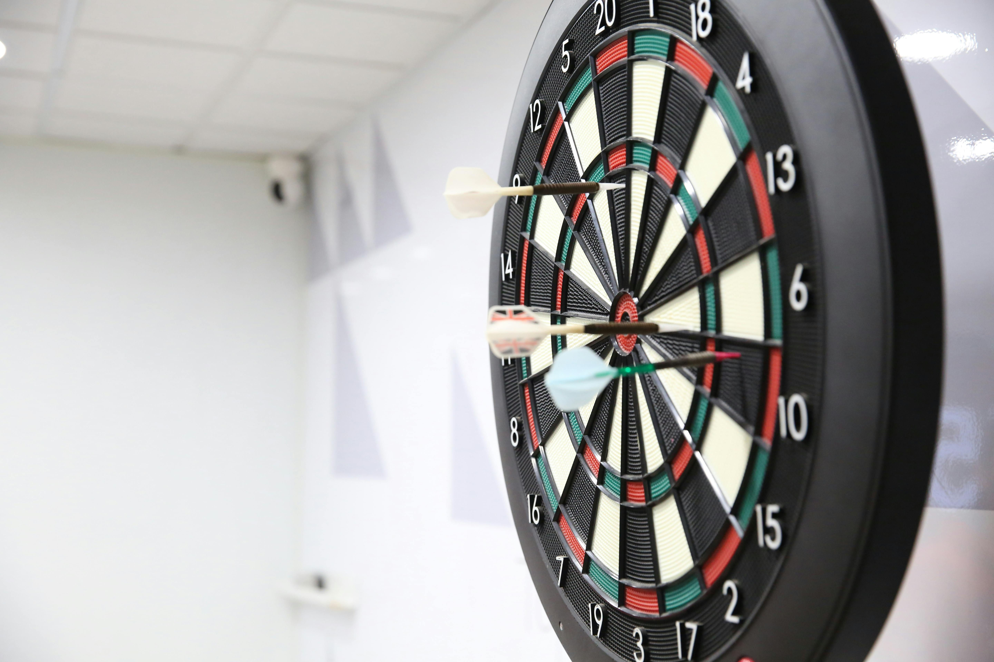
Near misses
Pokies make people think they have won, even when they haven’t
Designed to trick the brain
This is not an accident or coincidence
Gambling providers always benefit
Notes:
Speaker’s notes:
Some gambling products, like pokies, make our brains think that we’re winning, even if we’re not. Their design – such as flashing lights, confetti and celebratory sounds – can trick our brains into thinking we’ve won, or almost won. These are called “near misses”. Research has found that near misses have the same impact on the brain as an actual win. It triggers the brain to release dopamine, making us want to gamble more and more.
It’s important to remember that this isn’t an accident or coincidence. Pokies are programmed using sophisticated psychological techniques to maximise users’ bet sizes and time spent on the machine. This contributes to the game’s potential to be addictive.
References:
Anselme, P., & Robinson, M. J. (2013). What motivates gambling behavior? Insight into dopamine's role. Frontiers in behavioral neuroscience, 7, 182. https://doi.org/10.3389/fnbeh.2013.00182
Australian Gambling Research Centre. (2017). How electronic gambling machines work. Australian Institute of Family Studies. https://aifs.gov.au/resources/policy-and-practice-papers/how-electronic-gambling-machines-work

Slide 6
Near misses
Notes:
Speaker’s notes:
This video provides some useful insight into how near misses impact the brain.
References:
Victorian Responsible Gambling Foundation. (2019). Can You Beat The Odds – The Near Miss Effect. https://www.youtube.com/watch?v=jS9LjzPPRmA

Slide 7
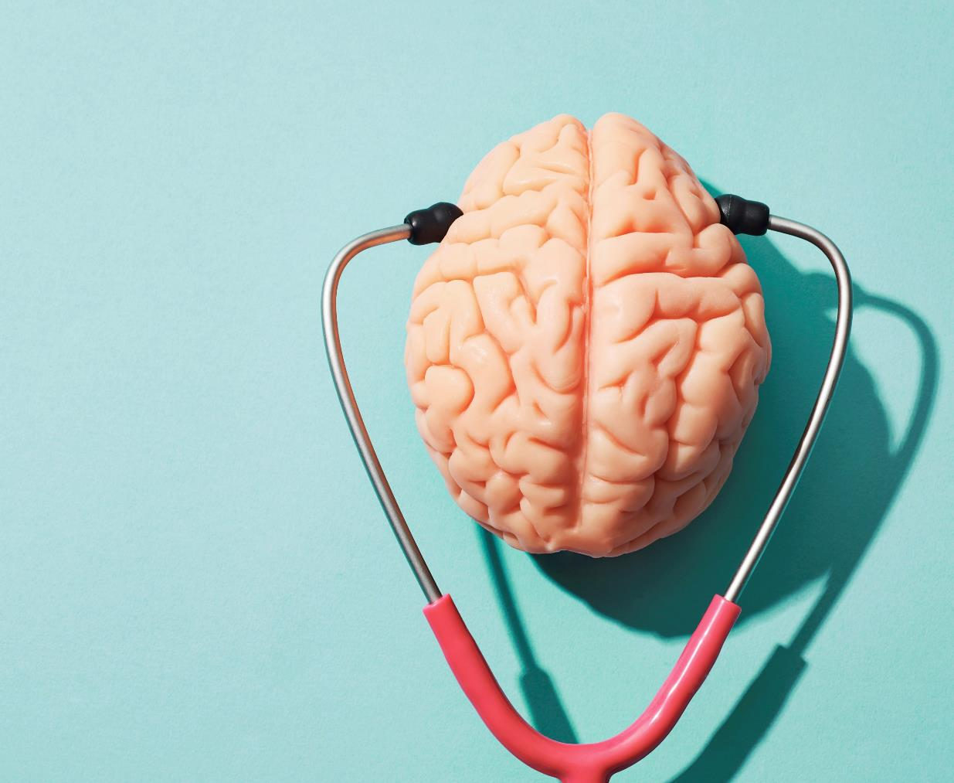
The impact on the brain
Impacts information processing and decision-making
Can lead to symptoms of withdrawal
Similar effect on the brain to alcohol or drugs
Notes:
Speaker’s notes:
An excess amount of dopamine in the brain can have big impacts. When someone gambles too often, it can affect the way they process information, control impulses and weigh up risks. In some cases, when a person is experiencing severe gambling harm, they can go through symptoms of withdrawal, such as distress, agitation and insomnia – similar to the experiences of alcohol or drug abuse. This is how it can become difficult to stop gambling.
References:
Anselme, P., & Robinson, M. J. (2013). What motivates gambling behavior? Insight into dopamine's role. Frontiers in behavioral neuroscience, 7, 182. https://doi.org/10.3389/fnbeh.2013.00182

Slide 8
Tips for safer gambling
Understand the risk
Set limits with your money
Set limits with your time
Gamble with a clear mind
Maintain balance in life
Notes:
Speaker’s notes:
These tips can help you avoid gambling harm and practice safer gambling.
Tip 1: Understand the risk.
When we’re honest with ourselves about the risks of gambling, it’s easier to understand that the likelihood of winning isn’t very high. Remember the gambling industry exists to make a profit. There is a high chance you will lose, and the odds will always be in the house’s favour.
Tip 2: Set limits with your money.
Decide in advance the amount of money you will spend on gambling per week or month. Keep an eye on your current and past spending. Try look for patterns or trends.
Tip 3: Set limits with your time.
It can be easy to lose track of time. Set start times and finish times for when you will gamble. Choose an ideal duration for play. Set a timer to remind you to stop or take a break in play.
Tip 4: Only gamble with a clear mind.
Sometimes when we’re having fun, we can be tempted to gamble while drinking or using drugs. But this can be dangerous as it changes the way we make decisions. Likewise, try not to gamble when you’re feeling down, stressed or bored as this can also lead us to make different choices.
Tip 5: Maintain balance in your life.
Remember that gambling shouldn’t take up all of your time. It is important to balance your time with other important things in your life, like spending time with friends and family, playing a sport or starting a creative project. If you find that your gambling is taking up too much of your time or you’re spending less time partaking in other important parts of your life, it might be time to seek help.
References:
Gambling Help Queensland. (2024). Tips for Safer Gambling. https://www.gamblinghelpqld.org.au/tips-to-avoid-risky-gambling
Multnomah County. (2024). 10 Tips for Safer Gambling. https://www.multco.us/behavioral-health/10-tips-safer-gambling
Responsible Gambling Council. (2024). Take a Safer Approach to Gambling: How to take precautions from the risks of gambling (especially online). https://www.responsiblegambling.org/for-the-public/safer-play/safer-gambling-tips/

Slide 9
Questions?

