Slide 1
Gambling and the justice sector
Notes:
Version: October 2024.

Slide 2
Overview
Gambling and the justice sector
Gambling-related offences
Rates of gambling harm
Other considerations
Support services
Notes:
Speaker’s notes:
In this module, we’re going to talk about the link between gambling and the justice sector. We’ll explore common gambling-related crimes, and available support services.
The justice sector in Queensland delivers judicial processes, manages prisoners and offenders, and provides rehabilitation services. Agencies that deliver these services include Corrective Services, Courts, and the Office of the Director of Public Prosecutions.

Slide 3
Gambling harm and the justice sector
The intersection between gambling and the justice sector is complex.
Gambling can lead people to offend.
It can also result from contact with the justice sector.
Notes:
Speaker’s notes:
The intersection between gambling harm and the justice sector is complex. A 2017 study in Victoria found that there are many potential pathways which can take people between gambling and contact with the justice sector. One example is when a person develops problems with gambling and then commits an offence – such as theft or drug trafficking – to resource their gambling. However, there are many factors that can contribute to and result from gambling behaviour, and make people more vulnerable to contact with the justice system as a result. Some of these factors are poor physical or mental health, addiction, and a lack of social supports.
The path between gambling and crime can also move in the opposite direction. In this scenario, a person may develop a gambling behaviour after or at the same time as they start engaging in criminal activities.
References:
Centre for Innovative Justice, RMIT (2017). Compulsion, convergence or crime? Criminal justice system contact as a form of gambling harm. https://cij.org.au/cms/wp-content/uploads/2018/08/gambling-harm-report.pdf

Slide 4
Gambling and offending
People experiencing gambling harm might commit crimes to fund gambling or pay off their debts
Can include theft, fraud, or bribery
Research suggests people gamble to fund illicit drug use.
Notes:
Speaker’s notes:
There are some common types of gambling-related offences. Sometimes, people experiencing gambling harm commit crimes to fund their gambling or pay off their debts. This might include fraud, theft, or bribery.
Research also suggests a link between gambling and illicit drug use. A survey of people in offenders’ rehabilitation in South Australia found 45% of people who had issues with gambling, gambled to support their drug use. 57.5% reported that drug use made their gambling issues worse, and 45% said they had used drugs to deal with stress resulting from gambling.
In rare cases, a person may be penalised for breaching a venue exclusion under Queensland’s gambling legislation. Mandatory exclusion orders prohibit a person from entering or remaining in a gambling venue.
References:
Gambling Help Online. (2024). Resolving legal challenges. https://www.gamblinghelponline.org.au/support-yourself-or-others/maintaining-change/resolving-legal-challenges
Paterson, A and Garrett, L (2010) Report into the possible connection between problem gambling, drug usage and criminal activity among clients of the Offenders Aid & Rehabilitation Services of SA Inc. https://www.cbs.sa.gov.au/documents/possible-connection-between-problem-gambling-and-crime-oars-2010-webcc80.pdf

Slide 5
Domestic and family violence
People who have issues with their gambling can be more likely to:
Experience violence in their families
Act violently themselves
Notes:
Speaker’s notes:
Sometimes, issues with gambling and domestic and family violence happen together. People who have issues with their gambling can be more likely than others to experience violence in their families and to act violently themselves.
Research suggests that gambling does not directly cause violence in families or the other way around, but that they can be linked in several ways. For example:
People who gamble can be violent towards their family members as their own gambling losses and other consequences increase.
Family members can be violent towards the person who gambles as their gambling losses and other consequences increase.
Gambling can be a way to physically or emotionally escape violence from family members.
Gambling can be a way for people to cope with their own violent behaviour within their families.
References:
Gambling Help Online. (2024). Resolving legal challenges. https://www.gamblinghelponline.org.au/support-yourself-or-others/maintaining-change/resolving-legal-challenges
Dowling, N et al. (2014) Problem gambling and Intimate Partner Violence: A Systematic Review and Meta-Analysis. Sage Journals – Trauma, Violence & Abuse

Slide 6
Queensland research
In 2004, a survey of people on Community Corrections Orders revealed 9.4% experienced problem gambling.
17 times higher than the general adult population.
Notes:
Speaker’s notes:
A survey conducted in 2004 of Queenslanders on Community Corrections Orders – that is, either community service orders or post-prison community-based release (parole) – found 9.4% experienced problem gambling. At the time, that was 17 times higher than the general population. The same study found 41% of those who had experienced problem gambling had committed gambling-related offences.
Although more recent Queensland-based data is not available, a similar survey on people in Victorian prison facilities in 2013 found that 33% had experienced problem gambling within the preceding year. 88% of these people reported that they had committed gambling-related crimes. Overall, research suggests rates of gambling harm are much higher throughout the criminal justice system, both in Australia and internationally.
References:
Queensland Corrective Services (2005) Games people play – Problem gambling among offenders in Queensland Community Corrections. https://www.publications.qld.gov.au/dataset/liquor-and-gambling-research/resource/91250112-b279-416a-908a-ef9a71d60988
Victorian Responsible Gambling Foundation (2014) Complex lives: Co-occurring conditions of problem gambling. https://responsiblegambling.vic.gov.au/documents/24/complex-lives-co-occurring-conditions-of-problem-gambling.pdf

Slide 7
What you can do
Gambling can be a factor in a person reoffending.
Greater awareness and understanding can lead to improved outcomes.
Notes:
Speaker’s notes:
Research suggests gambling can be a factor in people reoffending after leaving the justice system. People who have been imprisoned sometimes identify gambling as their biggest risk factor upon release, largely due to the debts that can await them post sentence or incarceration.
It is important for staff working the justice sector, and people interacting with the justice sector, to understand the relationship between gambling harm and other conditions that could lead to offending. This can assist in treatment approaches for people experiencing gambling harm, and improved outcomes.
References:
Centre for Innovative Justice, RMIT (2017). Compulsion, convergence or crime? Criminal justice system contact as a form of gambling harm. https://cij.org.au/cms/wp-content/uploads/2018/08/gambling-harm-report.pdf
Victorian Responsible Gambling Foundation (2014) Complex lives: Co-occurring conditions of problem gambling. https://responsiblegambling.vic.gov.au/documents/24/complex-lives-co-occurring-conditions-of-problem-gambling.pdf

Slide 8
Gambling harm screening
Problem Gambling Severity Index (PGSI)
Self-assessment of gambling behaviour over the last 12 months
Nine items
The higher the score, the more severe the impact of gambling
For more information, visit gamblinghelponline.org.au
Notes:
Speaker’s notes:
People in the justice sector are often experiencing complex issues, and gambling harm may not be easy to identify. There are several tools available to screen for gambling harm. These can help you identify gambling harm early and provide timely support and assistance to the people you’re working with.
The most popular gambling harm screening tool is the Problem Gambling Severity Index (PGSI). The PGSI is the standardised measure of at-risk behaviour for gambling harm, based on research on the common signs and consequences of harmful gambling. The PGSI quiz asks participants to self-assess their gambling behaviour over the past 12 months by scoring themselves against nine items. The higher their score, the more severe the impact that gambling is having on the patient’s life. There is information on other screening tools on the website on this slide, at the page “Identifying gambling harm”.
References:
GambleAware. (2024). How to identify a patient’s gambling issues. https://www.gambleaware.nsw.gov.au/for-professionals/for-general-practitioners/how-to-identify-a-patients-gambling-issues
Victorian Responsible Gambling Foundation. (2024). Screening and supporting patients for gambling harm. https://responsiblegambling.vic.gov.au/for-professionals/health-and-community-professionals/screening-and-supporting-patients
Gambling Help Online. (2024). Identifying gambling harm. https://www.gamblinghelponline.org.au/support-yourself-or-others/taking-action/identifying-gambling-harm?language_content_entity=en
Dowling, N. A., Merkouris, S. S., Dias, S., et al. (2019). The diagnostic accuracy of brief screening instruments for problem gambling: A systematic review and meta-analysis. Clinical psychology review, 74, 101784. https://doi.org/10.1016/j.cpr.2019.101784

Slide 9
Support services
Free and confidential counselling
Support is available either face-to-face, over the phone or online
Phone us:
Visit our website:
Notes:
Note for presenter:
Please include the relevant GHS phone number and hours.
Speaker’s notes:
Gambling Help services work with other organisations in the community to increase understanding of gambling harm and provide free and confidential advice, support and counselling where required. We can assist people experiencing harm from their own gambling, or someone close to them.
Feel free to talk to us about how we can connect in with solutions for people in the justice sector who may be experiencing gambling harm.

Slide 10
Other local support services
Support service | Contact information
Mental health support
Domestic and family violence
Alcohol and other drug use
Financial counselling
Notes:
Note for presenter:
Please include a list of some other local support services.
Speaker’s notes:
We’ve compiled a list of some of the other support services in our area, including services to help people experiencing mental health concerns, domestic and family violence, alcohol and other drug use, or financial difficulty.

Slide 11
Gambling Help support services
Gambling Help Queensland
1800 858 858
www.gamblinghelpqld.org.au
Gambling Help Online
1800 858 858
www.gamblinghelponline.org.au
Notes:
Speaker’s notes:
There are also other services available, outside of our local area. Gambling Help Queensland provide 24/7 support for anyone affected by gambling across Queensland, through their free Helpline displayed on screen. Find more information at the Gambling Help Queensland website.
Gambling Help Online provide 24/7 free online support across Australia. You can speak to a counsellor either on an online chat, email or over the phone at any time of the day. You can find more information at the Gambling Help Online website.
References:
Gambling Help Queensland. (2024). Home. www.gamblinghelpqld.org.au
Gambling Help Online. (2024). Home. www.gamblinghelponline.org.au

Slide 12
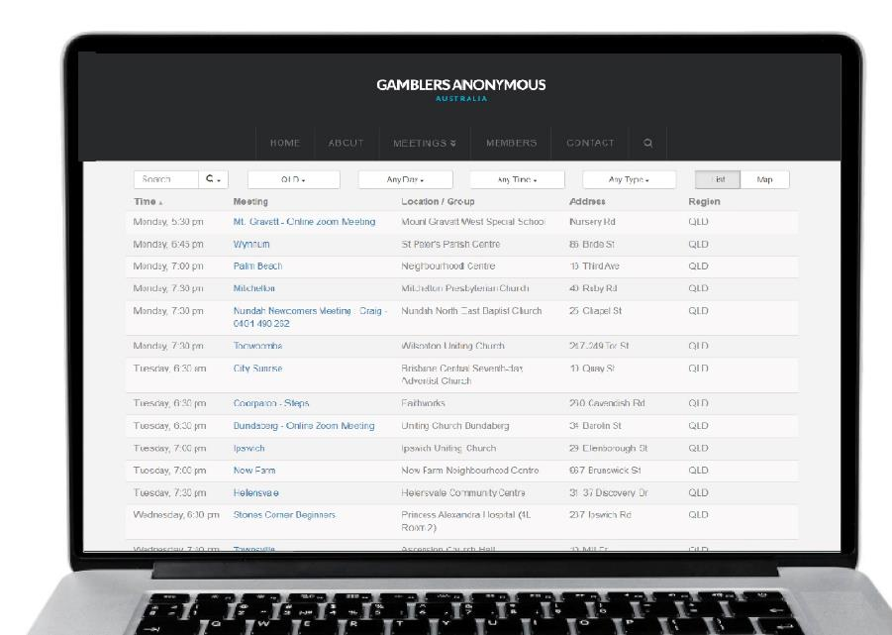
Group therapy support services
Gamblers Anonymous Queensland
0467 655 799
www.gaaustralia.org.au
Gam-Anon Queensland
0467 655 799
www.gaaustralia.org.au/gam-anon/
Notes:
Speaker’s notes:
There are also various support groups available. Gamblers Anonymous Queensland provides group therapy and support across Queensland. Members can meet either face-to-face or online, either weekly or whenever suits them, to listen and speak with other people who are experiencing similar gambling-related challenges. You can find more information about session times and locations at the Gamblers Anonymous Australia website, by clicking the ‘Queensland meetings’ tab.
Similarly, Gam-Anon Queensland provides group therapy for people impacted by someone else’s gambling, including partners, family, friends and colleagues. Members can also meet either face-to-face or online. You can find more information at the website on screen.
References:
Gamblers Anonymous. (2024). Home. www.gaaustralia.org.au

Slide 13
Questions?

