Slide 1
Starting the conversation
Help for family and friends
Notes:
Version: September 2024.

Slide 2
Overview
Your role
The bigger picture
Get ready for the conversation
Language matters
During the conversation
What happens next?
Dealing with challenges
Support services
Notes:
Speaker’s notes:
Family and friends can play a key role in supporting someone who is experiencing gambling harm. Whilst many people can recognise that they are experiencing gambling harm by themselves, others might need support from family and friends to help them realise the impact of their gambling. If you are concerned about your friend or family member’s gambling, talking to them about your concerns can be a helpful approach. In the next few slides, we’re going to talk about how to start the conversation with someone who gambles. We’ll start with an introduction into your role as a family member or friend, talk about the many different factors that influence someone’s gambling, explore things to think about before and during the conversation, what happens after the conversation, and pathways for support.

Slide 3
Your role
You can help them create change in their own life
You can’t ‘fix’ or force change on the person who gambles
Always prioritise yourself – never start conversations where you feel unsafe
Notes:
Speaker’s notes:
Before we start, it is important to remember what your role looks like as a friend or family member. While you can support someone to enact change in their own life, it is never your responsibility to “fix” or force change on the person who gambles. Remember that your role is to help them take the next step. Likewise, it’s important to always prioritise yourself. Never start conversations where you might feel unsafe. Look after yourself first and support your loved one second. If you feel your safety is in danger, call Triple Zero (000).
References:
Gambling Help Queensland. (2024). Talking to someone about their gambling. https://www.gamblinghelpqld.org.au/talking-to-someone-about-their-gambling
Office for Problem Gambling. (2024). How to start the conversation. https://www.problemgambling.sa.gov.au/help-someone/start-the-conversation/how-to-start-the-conversation

Slide 4
The bigger picture
Gambling harm is often tied to other factors in a person’s life
Family crisis or relationship breakdown
Financial stress
Mental ill-health
Substance misuse
Domestic and family violence
Be mindful of how these factors might impact your loved one’s gambling
Notes:
Speaker’s notes:
Let’s start by talking about gambling as a whole picture. Imagine your friend or family member’s gambling behaviours like an iceberg. What you see on the surface of the water might be a strong urge or addiction to gambling, but underneath lies so much more. Research tells us that gambling is often tied to many other factors in a person’s life, including mental ill-health, family crisis or relationship breakdown, financial stress, substance misuse, experiences of domestic and family violence, or other life stresses from work or study. Often, people who are experiencing gambling harm and struggling with other parts of their life usually experience these other challenges first and use gambling as a coping mechanism. However, it can also work the other way too – where people who are experiencing gambling harm also struggle with other life challenges because of their gambling. When speaking with your family member or friend, try to be mindful of how the different parts of somebody’s life can affect a person and the choices they make. Do your best to create a safe and supportive environment for your loved one to speak about other personal considerations, including asking them if they would like to speak to someone from a support service.
References:
Gambling Help Queensland. (2024). Talking to someone about their gambling. https://www.gamblinghelpqld.org.au/talking-to-someone-about-their-gambling

Slide 5
Get ready for the conversation
Choose an appropriate time and place
Plan the conversation
Know the facts
For more information, visit gamblinghelpqld.org.au
Notes:
Speaker’s notes:
Before you talk to your loved one, it’s a good idea to first have a plan. Start by thinking about an appropriate time and place to speak to your friend or family member. Choose a safe, comfortable place to speak. This place should be private, free from distractions, and relaxed. Choose an appropriate time for this conversation. It should be when you are both relaxed, not rushed, and unlikely to be distracted. It’s a good idea to check in with yourself too. Think about what emotional state you are in and choose a time and place where you are in control of your emotions and in the right headspace to talk calmly.
Next, plan the conversation. Think about what you’d like to say and how you’d like to say it. Practise it a few times. It might also help to think about how your loved one might respond and prepare for their reaction by thinking about what you can say in response.
Finally, know the facts. Many people have false ideas about gambling and how it works. It can help to talk to your loved one about gambling facts, such as the odds of winning or its impact on the brain. You can find more information on the Gambling Help Queensland website.
Note for presenter:
Further information is also available in Module 3 – Gambling and the brain, and Module 4 – Odds of winning.
References:
Gambling Help Queensland. (2024). Talking to someone about their gambling. https://www.gamblinghelpqld.org.au/talking-to-someone-about-their-gambling
Office for Problem Gambling. (2024). How to start the conversation. https://www.problemgambling.sa.gov.au/help-someone/start-the-conversation/how-to-start-the-conversation

Slide 6
Language matters
Use words that describe the ways gambling might be impacting you or your loved one’s life
Focus on using “I” statements
“I feel that gambling is affecting our relationship."
“I’m worried about the way gambling is impacting other areas of your life.”
Notes:
Speaker’s notes:
It’s important to be mindful of the words you use when you speak to your loved one about their gambling. The words we use to talk about gambling can have big impacts. Using words which are critical or belittling, which nag or put blame and shame on your loved one or their behaviour aren’t helpful to the conversation. Instead, try using words that describe the ways gambling might be impacting your or your loved one’s life. A helpful way to do this is by using “I” statements. “I” statements centre the conversation around feelings, rather than behaviours. They help the person you’re speaking to understand that you want to help, that you are concerned, and reduces feelings of blame or accusations for the other person. This might look like: “I feel that gambling is affecting our relationship.“, or “I’m worried about the way gambling is impacting other areas of your life.“
References:
Gambling Help Queensland. (2024). Talking to someone about their gambling. https://www.gamblinghelpqld.org.au/talking-to-someone-about-their-gambling
GambleAware. (2024). Start the conversation. https://www.gambleaware.nsw.gov.au/supporting-someone/supporting-family-and-friends/starting-the-conversation

Slide 7
During the conversation
Start positive – remind them you are there for them
Listen to their perspective
Don’t judge their choices or beliefs
Let them know their feelings are valid and important
Notes:
Speaker’s notes:
When you begin the conversation, it’s a good idea to start positive. Tell the person that they are important to you, you care about them, and you are there for them. Highlight things you value about them and the strengths you have noticed they use to resolve other problems.
During the conversation, make sure you listen to your friend or family member. Ask them for their perspective and give them time to tell their story. Try to listen without interrupting, arguing, or correcting their experience. Try to understand where your friend or family member is coming from. Consider their perspective and their experiences and don’t judge their choices or beliefs. Make sure you let them know their feelings are valid. Remind them you're there for them and they are not alone. Reassure them that you care and want to help.
References:
Gambling Help Queensland. (2024). Talking to someone about their gambling. https://www.gamblinghelpqld.org.au/talking-to-someone-about-their-gambling

Slide 8
What happens next?
For more information, visit gamblinghelpqld.org.au
Self-help
Self-exclusion
Support services
Notes:
Speaker’s notes:
During the conversation with your loved one, you might learn that your friend or family member is wanting to make changes to their gambling. There are different ways they can do this. Together, you could explore ways your loved one could support themselves; your loved one could ban themselves from a gambling venue or product; or you and your loved one could seek help from our support services. You can find more information about each of these different pathways at the Gambling Help Queensland website.
References:
Gambling Help Queensland. (2024). Let us help you. https://www.gamblinghelpqld.org.au/let-us-help-you

Slide 9
Dealing with challenges
If your friend or family member isn’t ready to make a change:
Remember it is not your responsibility to force change
Continue to watch out for the signs of gambling harm
Maintain open communication
Notes:
Speaker’s notes:
When you have the conversation with your loved one about their gambling, there’s a chance they might not be ready to talk. If your friend or family member isn’t ready to make a change in their life, remember it is not your responsibility to force that change. Instead, you can continue to watch out for the signs of gambling harm in your loved one by keeping an eye on them. Try to keep open communication with your friend or family member. Remind them that you're there for them if they need you and try speaking to them again at another time.
References:
Gambling Help Queensland. (2024). Talking to someone about their gambling. https://www.gamblinghelpqld.org.au/talking-to-someone-about-their-gambling

Slide 10
Support services
Free and confidential counselling
Support is available either face-to-face, over the phone or online
Phone us:
Visit our website:
Notes:
Note for presenter:
Please include the relevant GHS phone number and hours.
Speaker’s notes:
If you or someone you know is experiencing gambling harm, you can seek help from our support services. We offer free and confidential counselling services to both the person experiencing gambling harm and the people close to them. You can seek this support either face-to-face, over the phone or online. Our counsellors will always provide non-judgmental support. We’ll talk about the reasons you’ve decided to seek help and make plans together for the changes we can make to your gambling, your relationships and your life. You can find our phone number and website on the screen.

Slide 11
Other local support services
Support service | Contact information
Mental health support
Domestic and family violence
Alcohol and other drug use
Financial counselling
Notes:
Note for presenter:
Please include a list of some other local support services.
Speaker’s notes:
Sometimes, people gamble because there are other factors in their life that are causing them stress or difficulty. We’ve compiled a list of some of the other support services in our area, including services to help people experiencing mental health concerns, domestic and family violence, alcohol and other drug use, or financial difficulty. You can also speak to one of our counsellors and they can get you in touch with the other support you need.

Slide 12
Gambling Help support services
Gambling Help Queensland
1800 858 858
www.gamblinghelpqld.org.au
Gambling Help Online
1800 858 858
www.gamblinghelponline.org.au
Notes:
Speaker’s notes:
There are also other services available, outside of our local area. Gambling Help Queensland provide 24/7 support for anyone affected by gambling across Queensland, through their free hotline displayed on screen. Find more information at the Gambling Help Queensland website.
Gambling Help Online provide 24/7 free online support across Australia. You can speak to a counsellor either on an online chat, email or over the phone at any time of the day. You can find more information at the Gambling Help Online website.
References:
Gambling Help Queensland. (2024). Home. www.gamblinghelpqld.org.au
Gambling Help Online. (2024). Home. www.gamblinghelponline.org.au

Slide 13
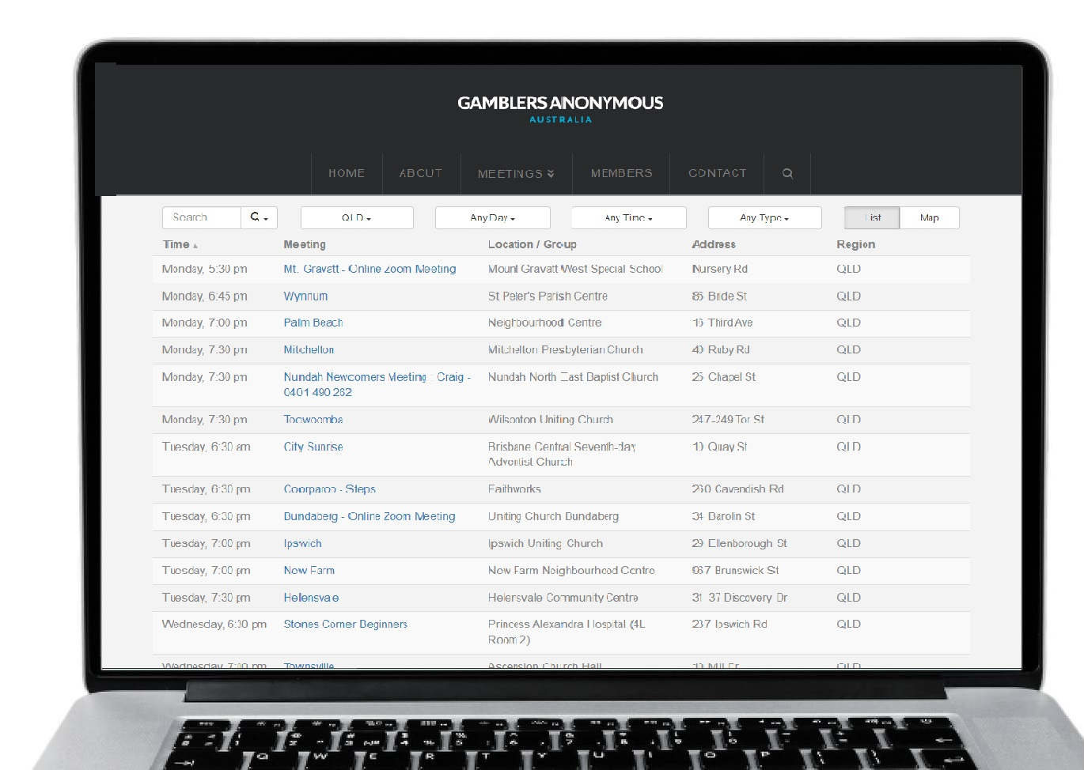
Group therapy support services
Gamblers Anonymous Queensland
0467 655 799
www.gaaustralia.org.au
Gam-Anon Queensland
0467 655 799
www.gaaustralia.org.au/gam-anon/
Notes:
Speaker’s notes:
There are also various support groups available. Gamblers Anonymous Queensland provides group therapy and support across Queensland. Members can meet either face-to-face or online, either weekly or whenever suits them, to listen and speak with other people who are experiencing similar gambling-related challenges. You can find more information about session times and locations at the Gamblers Anonymous Australia website, by clicking the ‘Queensland meetings’ tab.
Similarly, Gam-Anon Queensland provides group therapy for people impacted by someone else’s gambling, including partners, family, friends and colleagues. Members can also meet either face-to-face or online. You can find more information at the website on screen.
References:
Gamblers Anonymous. (2024). Home. www.gaaustralia.org.au

Slide 14
Gambling harm consultations
Do you have lived experience of gambling harm?
You can make a difference to the policies and programs that support people with lived experience of gambling harm in Queensland.
Register your interest at qld.gov.au/gamblingharmconsultations
Notes:
Speaker’s notes:
The Queensland Government is looking for people who have lived experience of gambling harm who would like to share their knowledge and expertise. By registering to share their experiences of gambling harm, Queenslanders can make a meaningful difference to ensure that the policies and programs developed by the Queensland Government better support the needs of people affected by gambling harm. If you have experienced gambling harm, either through your own gambling or someone else’s, you can share your voice by registering your interest on the Queensland Government website.
References:
Queensland Government. (2024). Gambling harm consultations. www.qld.gov.au/gamblingharmconsultations

Slide 15
Crisis support
Notes:
Speaker’s notes:
If anything we have talked about today raises immediate concern for you, please know you are not alone. Help is always available. You can call the number on the screen or visit the Lifeline website.
References:
Lifeline. (2024). Home. www.lifelineqld.org.au

Slide 16
Questions?

