Slide 1
Gambling and older people
Notes:
Version: September 2024.

Slide 2
Overview
Gambling harm
Signs of gambling harm
Gambling and older people
Risk factors
Louise’s story
Strategies for safer gambling
Support services
Notes:
Speaker’s notes:
In this module, we’re going to talk about gambling and older people. We’ll start by talking about a definition of gambling harm and the signs to keep an eye out for. Then, we’ll talk about the prevalence of gambling amongst older people in Queensland and common gambling behaviours in this age group. We’ll explore some of the common risk factors for experiencing gambling harm amongst people over age 55, watch a video from an older Queenslander who has lived experience of gambling harm and then talk about some tips for safer gambling and available support services.

Slide 3
Gambling harm
Any negative impact that gambling can have on a person and the people close to them
Includes
Health and wellbeing
Finances
Relationships
Culture
Work or study
Notes:
Speaker’s notes:
Gambling harm is a term used to describe the many ways that gambling can impact a person’s life. It refers to any negative impact that gambling can have on a person and the people close to them. It can include harm to a person’s health and wellbeing, their finances, their relationships, their culture, and their work or study.
Gambling harm can be experienced on a spectrum, ranging from minor or less frequent negative experiences to severe or ongoing impacts. It can be experienced by anybody, no matter how long a person has been gambling or how frequently. Gambling harm can even occur many years after a person’s actual gambling has stopped.
References:
Langham, E., Thorne, H., Browne, M., et al. (2015). Understanding gambling related harm: a proposed definition, conceptual framework, and taxonomy of harms. BMC Public Health, 16(1). https://doi.org/10.1186/s12889-016-2747-0

Slide 4
Signs of gambling harm
Financial signs
Emotional signs
Less money to spend
Decreased savings
Borrowing or taking money
Struggles to buy basic items
Needing financial assistance
Distress, shame or guilt
Struggles with self-worth
Less interest in goals or plans
Mental health concerns
Suicidal thoughts or behaviours
Notes:
Speaker’s notes:
It can be difficult to know if someone's gambling is harmful. It helps to understand some of the common signs of gambling harm so you can look out for it in yourself or someone you know. The common signs include financial signs, emotional signs, relationship signs, and health signs.
Financial signs include: having less money to spend on luxury items like holidays or electronics or spending less on non-gambling related entertainment like family outings and social activities; having decreased savings; borrowing or taking money from family or friends without their consent; spending less on family expenses like health care, education or insurance; struggling to buy basic items like food, housing, clothing or transport; or needing assistance to pay for bills from family, friends or welfare organisations.
Emotional signs include: seeming worried or distressed; struggling with self-worth or pride; seeming less interested in goals or plans for the future; reporting feeling hopeless, anxious or depressed; and struggling with suicidal thoughts.
References:
Langham, E., Thorne, H., Browne, M., et al. (2015). Understanding gambling related harm: a proposed definition, conceptual framework, and taxonomy of harms. BMC Public Health, 16(1). https://doi.org/10.1186/s12889-016-2747-0
Browne, M, Langham, E, Rawat, V, et al. (2016) Assessing gambling-related harm in Victoria: a public health perspective. Victorian Responsible Gambling Foundation, Melbourne.

Slide 5
Signs of gambling harm
Relationship signs
Health signs
Dishonest communication
Reduced engagement in family and social activities
Withdrawal or disengagement
Changes to diet
Decreased physical activity
Reduced sleep
Increased smoking, alcohol or drug intake
Notes:
Speaker’s notes:
Relationship signs – dishonestly communicating with others, including lying about or hiding gambling; reducing the quality and amount of time spent with others, including spending less time at family or social events; and becoming disengaged, withdrawn or neglectful of relationship responsibilities.
Health signs – making changes to diet, like choosing more takeout or junk food options; doing less physical activity; experiencing struggles with their sleep, either through reduced quality of sleep, time spent asleep or trouble getting to sleep; and smoking, drinking alcohol or using drugs more often.
References:
Langham, E., Thorne, H., Browne, M., et al. (2015). Understanding gambling related harm: a proposed definition, conceptual framework, and taxonomy of harms. BMC Public Health, 16(1). https://doi.org/10.1186/s12889-016-2747-0
Browne, M, Langham, E, Rawat, V, et al. (2016) Assessing gambling-related harm in Victoria: a public health perspective. Victorian Responsible Gambling Foundation, Melbourne.

Slide 6
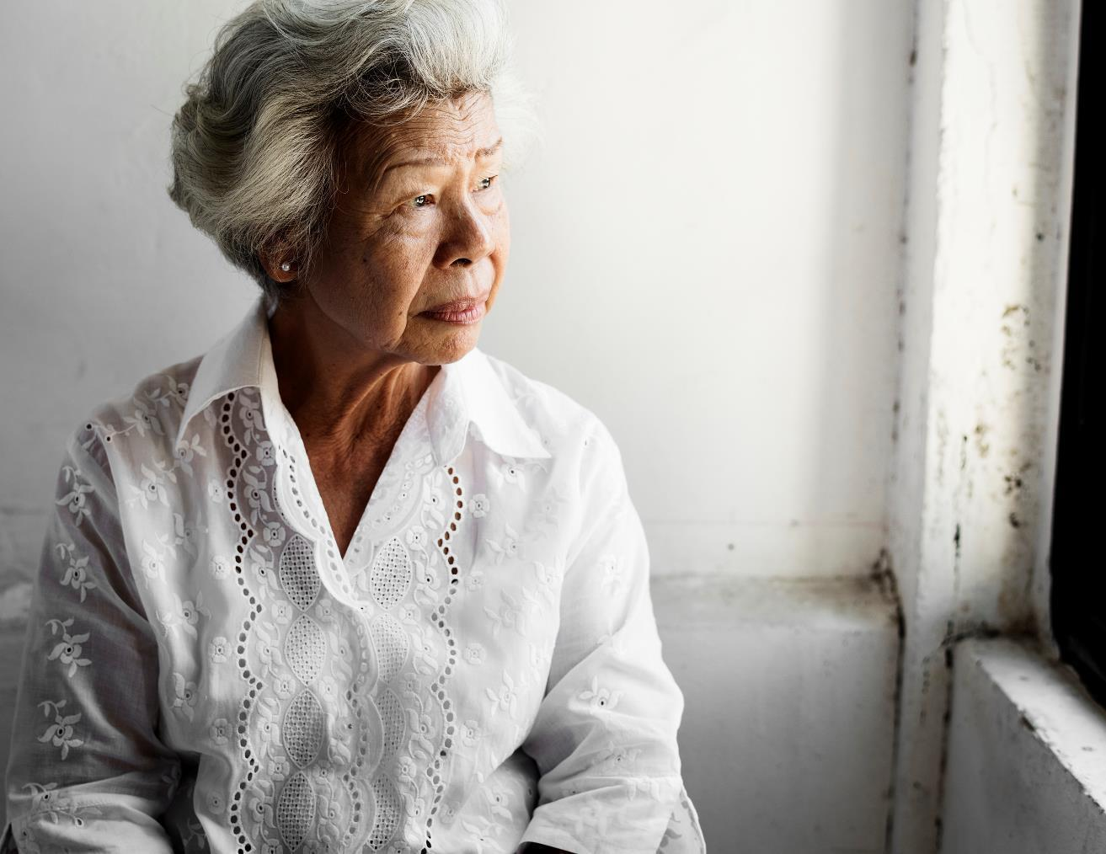
Gambling and older people
Generally, people over 55 years in Queensland are more likely to gamble than younger people
Older people mostly gamble on lottery products, instant scratch tickets and art union tickets
Older people who play the pokies tend to play more frequently than younger age groups
Notes:
Speaker’s notes:
Now, let’s talk about gambling amongst older people. According to the Queensland Gambling Survey 2023, people over 55 years were more likely to gamble than younger people, particularly on lottery products, instant scratch tickets and art union tickets. While older people who gamble were generally less likely to play the pokies than younger people, those that do tended to play more frequently than younger age groups and were much more likely to play in a club, rather than a pub or at the casino.
References:
Queensland Government. (2024). Queensland Gambling Survey 2023. https://www.publications.qld.gov.au/dataset/liquor-and-gambling-research

Slide 7
Risk factors
Major life changes, like retirement or the loss of a loved one
Boredom
Social isolation and loneliness
Physical limitations or mobility issues
Limited financial resources
Ease of access, like cheap meals for seniors or free shuttle buses
Notes:
Speaker’s notes:
Older people are more likely to gamble for several reasons, which can make them at risk of experiencing gambling harm. This can include gambling as a coping mechanism to deal with major life changes (like retirement, the loss of a loved one, or physical pain); to relieve boredom, social isolation and loneliness; excitement or stimulation; physical limitations or mobility issues which can prevent older adults from engaging in other activities they once enjoyed; limited financial resources from living on a fixed income or retirement funds; and ease of access and attractiveness of gambling venues (like cheap meals for seniors, free entertainment geared toward an older audience, and free shuttle buses to and from venues).
References:
Johnson, R.H., Pitt, H., Randle, M. et al. (2023). A scoping review of the individual, socio-cultural, environmental and commercial determinants of gambling for older adults: implications for public health research and harm prevention. BMC Public Health 23, 362. https://doi.org/10.1186/s12889-022-14930-y

Slide 8
Louise’s story
Notes:
Speaker’s notes:
It can help to understand what gambling harm looks and feels like by hearing it from someone who has experienced it. Louise is a mother and grandmother who lives in Hervey Bay in Queensland. This is her story.
References:
Office of Liquor and Gaming Regulation. (2021). 'When gambling took over...' Louise. https://www.youtube.com/watch?v=fQ0GD0_SzCk

Slide 9
Strategies for safer gambling
Understand the risk
Set limits with your money
Set limits with your time
Gamble with a clear mind
Maintain balance in life
Notes:
Speaker’s notes:
These strategies can help you avoid gambling harm and practice safer gambling.
Tip 1: Understand the risk.
When we’re honest with ourselves about the risks of gambling, it’s easier to understand that the likelihood of winning isn’t very high. Remember the gambling industry exists to make a profit. There is a high chance you will lose, and the odds will always be in the house’s favour.
Tip 2: Set limits with your money.
Decide in advance the amount of money you will spend on gambling per week or month. Keep an eye on your current and past spending. Try to look for patterns or trends.
Tip 3: Set limits with your time.
It can be easy to lose track of time. Set start times and finish times for when you will gamble. Choose an ideal duration for play. Set a timer to remind you to stop or take a break in play.
Tip 4: Only gamble with a clear mind.
Sometimes when we’re having fun, we can be tempted to gamble while drinking or using drugs. But this can be dangerous as it changes the way we make decisions. Likewise, try not to gamble when you’re feeling down, stressed or bored as this can also lead us to make different choices.
Tip 5: Maintain balance in your life.
Remember that gambling shouldn’t take up all of your time. It is important to balance your time with other important things in your life, like spending time with friends and family, playing a sport or starting a creative project. If you find that your gambling is taking up too much of your time or you’re spending less time partaking in other important parts of your life, it might be time to seek help.
References:
Gambling Help Queensland. (2024). Tips for Safer Gambling. https://www.gamblinghelpqld.org.au/tips-to-avoid-risky-gambling
Multnomah County. (2024). 10 Tips for Safer Gambling. https://www.multco.us/behavioral-health/10-tips-safer-gambling
Responsible Gambling Council. (2024). Take a Safer Approach to Gambling: How to take precautions from the risks of gambling (especially online). https://www.responsiblegambling.org/for-the-public/safer-play/safer-gambling-tips/

Slide 10
Support services
Free and confidential counselling
Support is available either face-to-face, over the phone or online
Phone us:
Visit our website:
Notes:
Note for presenter:
Please include the relevant GHS phone number and hours.
Speaker’s notes:
If you or someone you know is experiencing gambling harm, you can seek help from our support services. We offer free and confidential counselling services to both the person experiencing gambling harm and the people close to them. You can seek this support either face-to-face, over the phone or online. Our counsellors will always provide non-judgmental support. We’ll talk about the reasons you’ve decided to seek help and make plans together for the changes we can make to your gambling, your relationships and your life. You can find our phone number and website on the screen.

Slide 11
Other local support services
Support service | Contact information
Mental health support
Domestic and family violence
Alcohol and other drug use
Financial counselling
Notes:
Note for presenter:
Please include a list of some other local support services.
Speaker’s notes:
Sometimes, people gamble because there are other factors in their life that are causing them stress or difficulty. We’ve compiled a list of some of the other support services in our area, including services to help people experiencing mental health concerns, domestic and family violence, alcohol and other drug use, or financial difficulty. You can also speak to one of our counsellors and they can get you in touch with the other support you need.

Slide 12
Gambling Help support services
Gambling Help Queensland
1800 858 858
www.gamblinghelpqld.org.au
Gambling Help Online
1800 858 858
www.gamblinghelponline.org.au
Notes:
Speaker’s notes:
There are also other services available, outside of our local area. Gambling Help Queensland provide 24/7 support for anyone affected by gambling across Queensland, through their free hotline displayed on screen. Find more information at the Gambling Help Queensland website.
Gambling Help Online provide 24/7 free online support across Australia. You can speak to a counsellor either on an online chat, email or over the phone at any time of the day. You can find more information at the Gambling Help Online website.
References:
Gambling Help Queensland. (2024). Home. www.gamblinghelpqld.org.au
Gambling Help Online. (2024). Home. www.gamblinghelponline.org.au

Slide 13
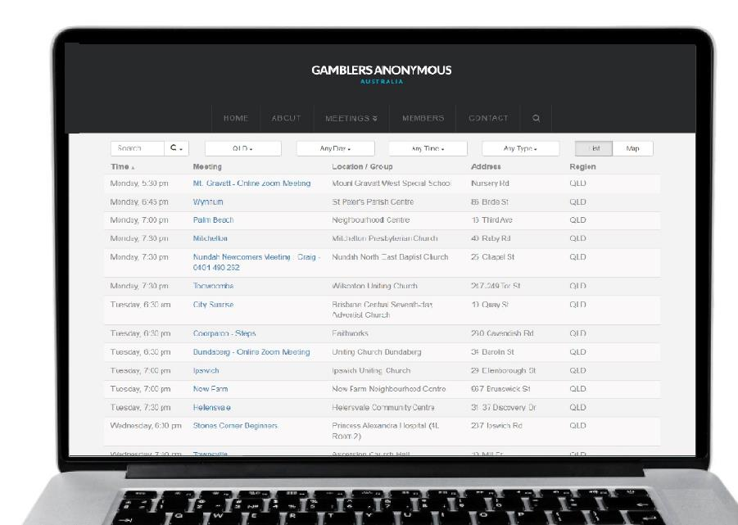
Group therapy support services
Gamblers Anonymous Queensland
0467 655 799
www.gaaustralia.org.au
Gam-Anon Queensland
0467 655 799
www.gaaustralia.org.au/gam-anon/
Notes:
Speaker’s notes:
There are also various support groups available. Gamblers Anonymous Queensland provides group therapy and support across Queensland. Members can meet either face-to-face or online, either weekly or whenever suits them, to listen and speak with other people who are experiencing similar gambling-related challenges. You can find more information about session times and locations at the Gamblers Anonymous Australia website, by clicking the ‘Queensland meetings’ tab.
Similarly, Gam-Anon Queensland provides group therapy for people impacted by someone else’s gambling, including partners, family, friends and colleagues. Members can also meet either face-to-face or online. You can find more information at the website on screen.
References:
Gamblers Anonymous. (2024). Home. www.gaaustralia.org.au

Slide 14
Questions?

